Slide 1
Sources of Water & Replenishment in the Coachella Valley
Maureen Perry
Education Specialist
Coachella Valley Water District

Slide 2
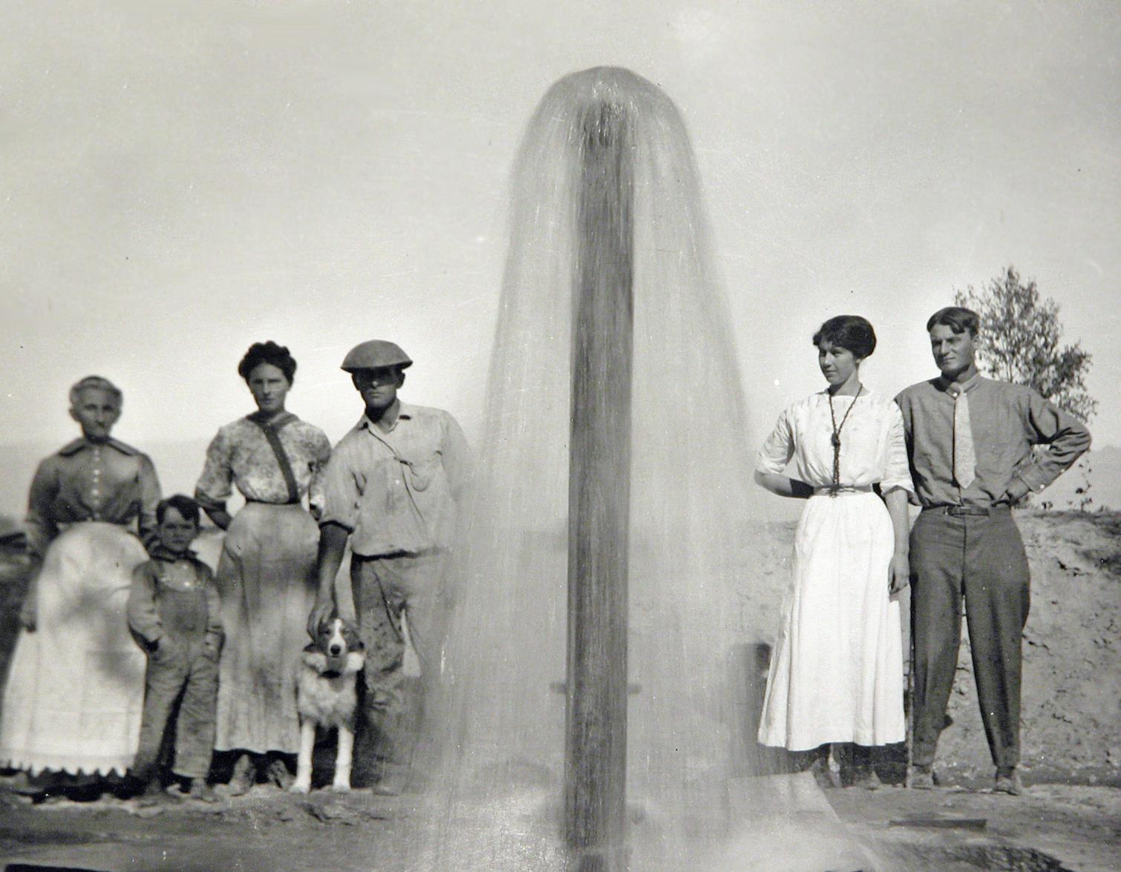
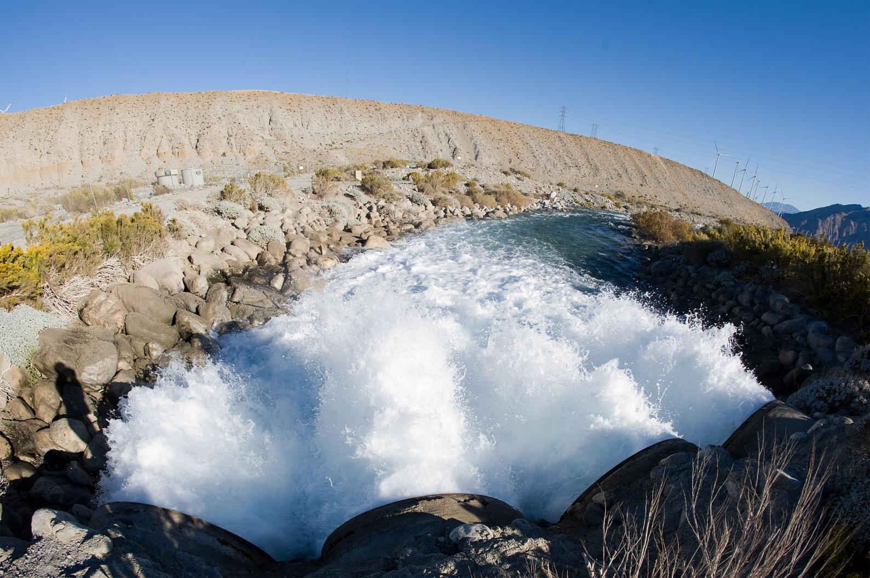
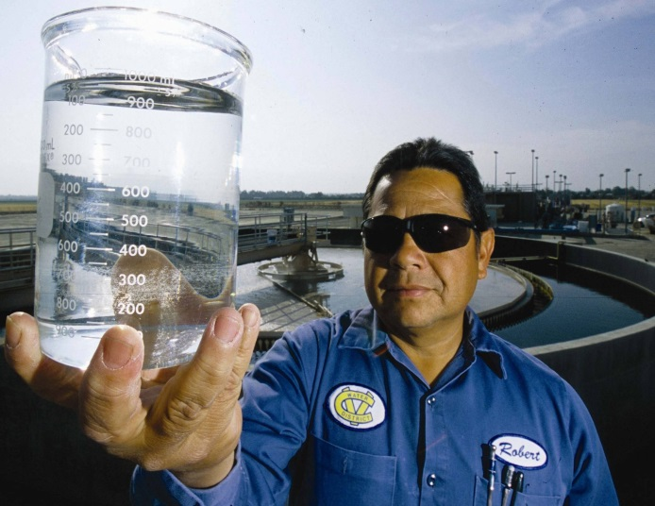
Federal
Ground
Federal
Ground
Our
4
Sources
Recycled
State
Recycled
State

Slide 3
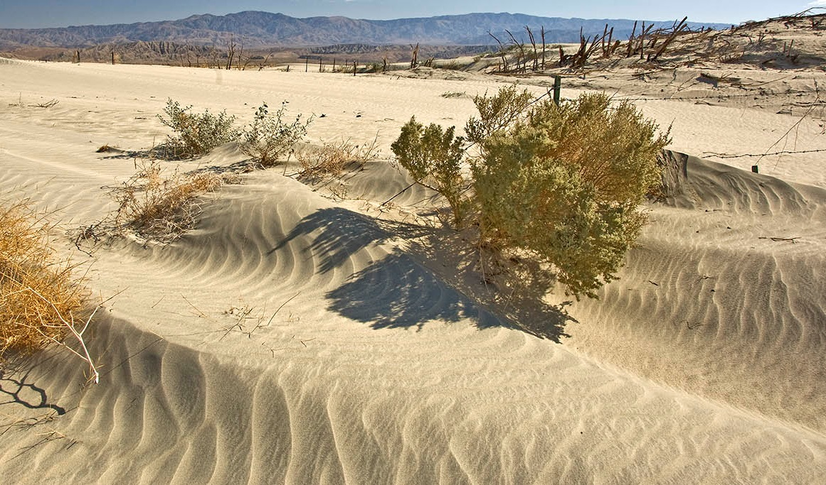
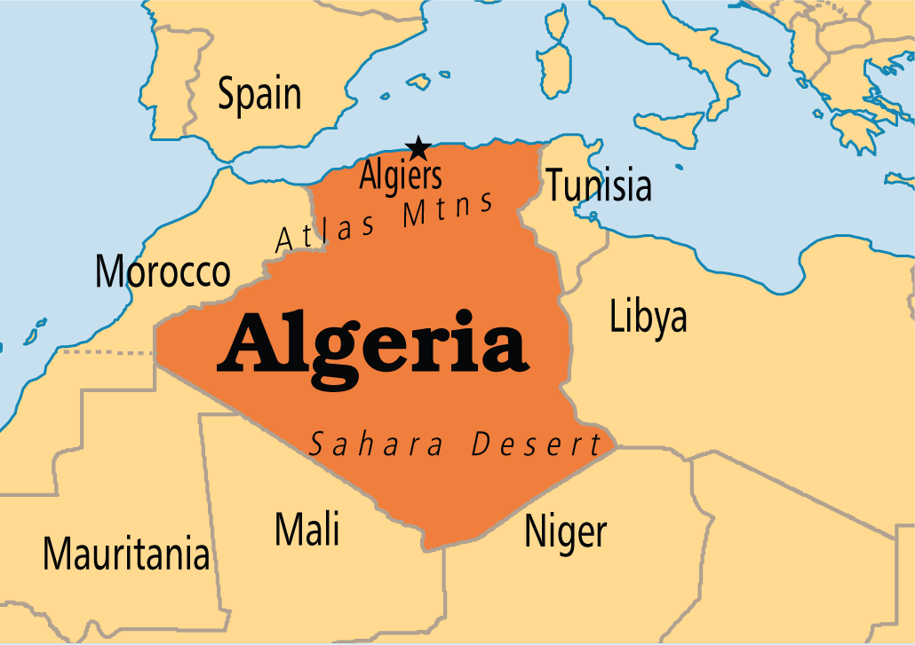
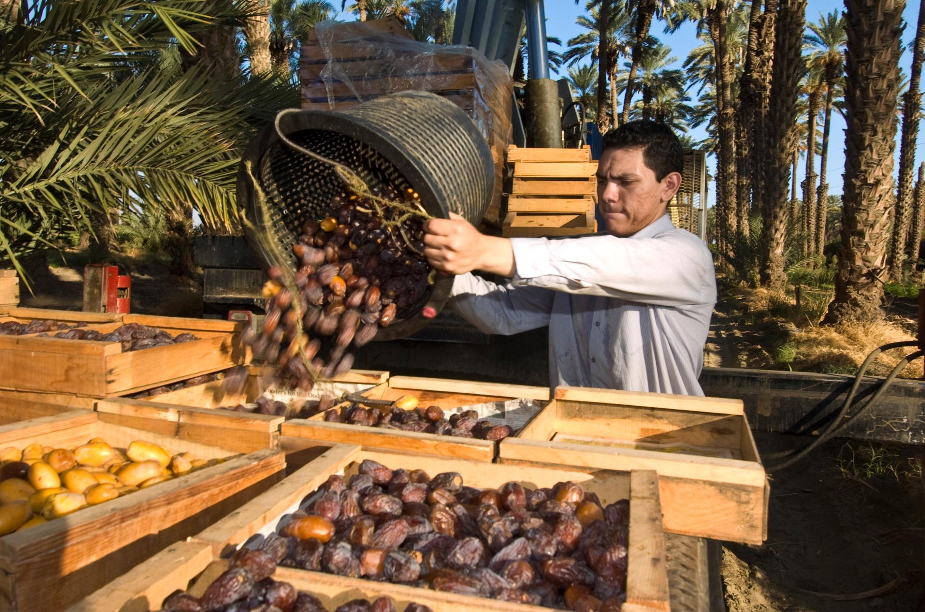

Slide 4
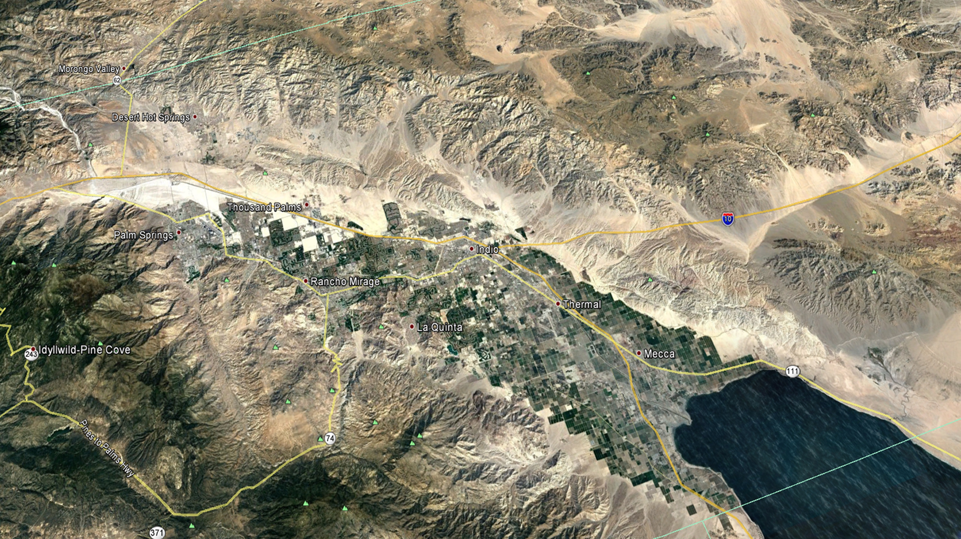
45
15

Slide 5
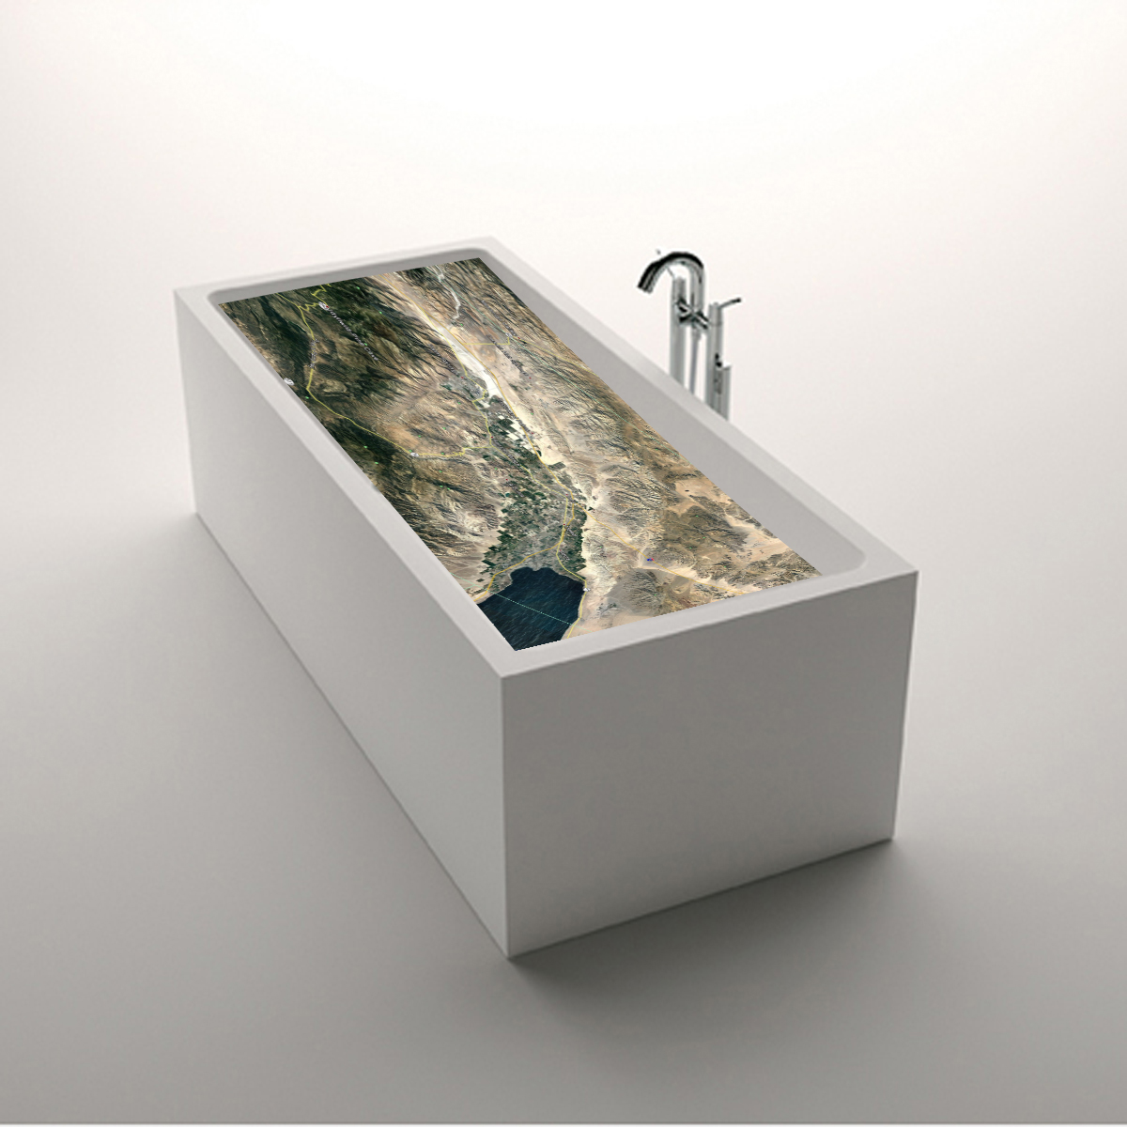
San Gorgonio Pass 1,600 ft.
Salton Sea - 232 ft.

Slide 6
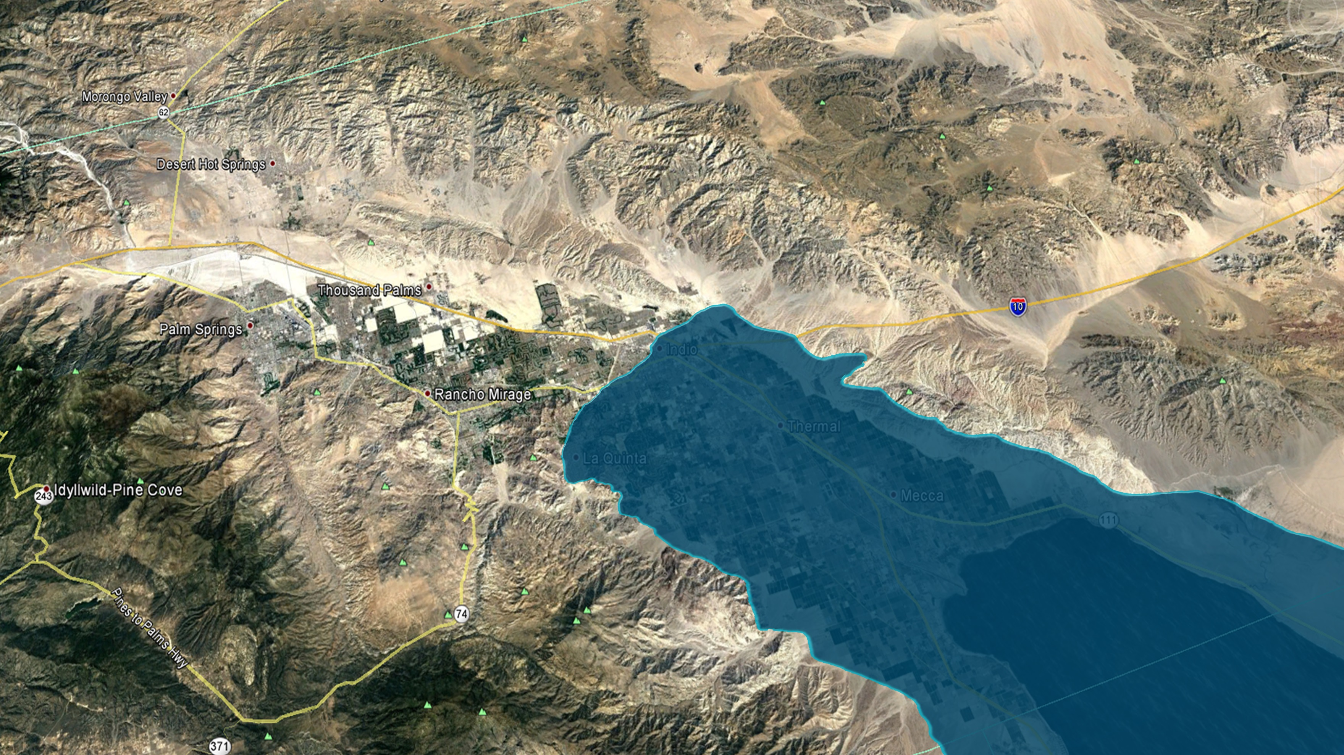
West Valley
East Valley

Slide 7
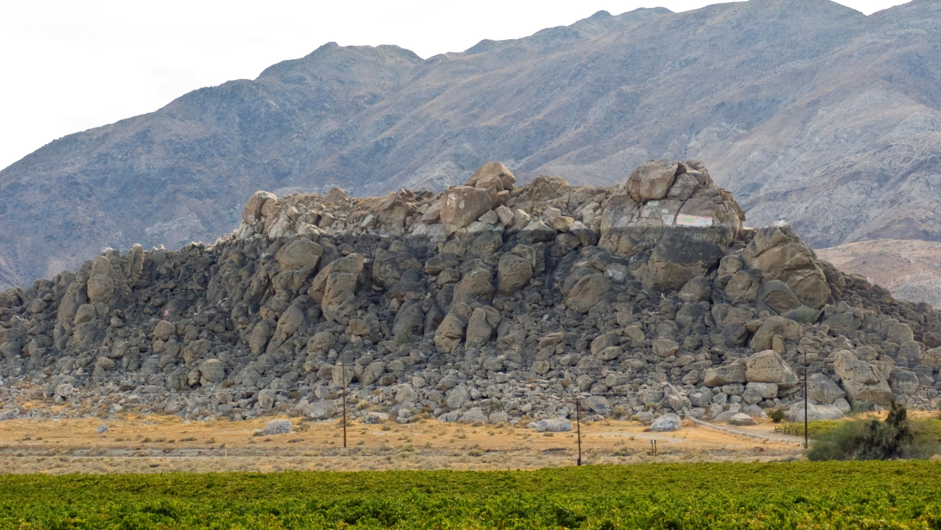

Slide 8
Artesian Water
West Valley
East Valley

Slide 9
West Valley
East Valley
UNCONFINED
39 MAF
CONFINED

Slide 10
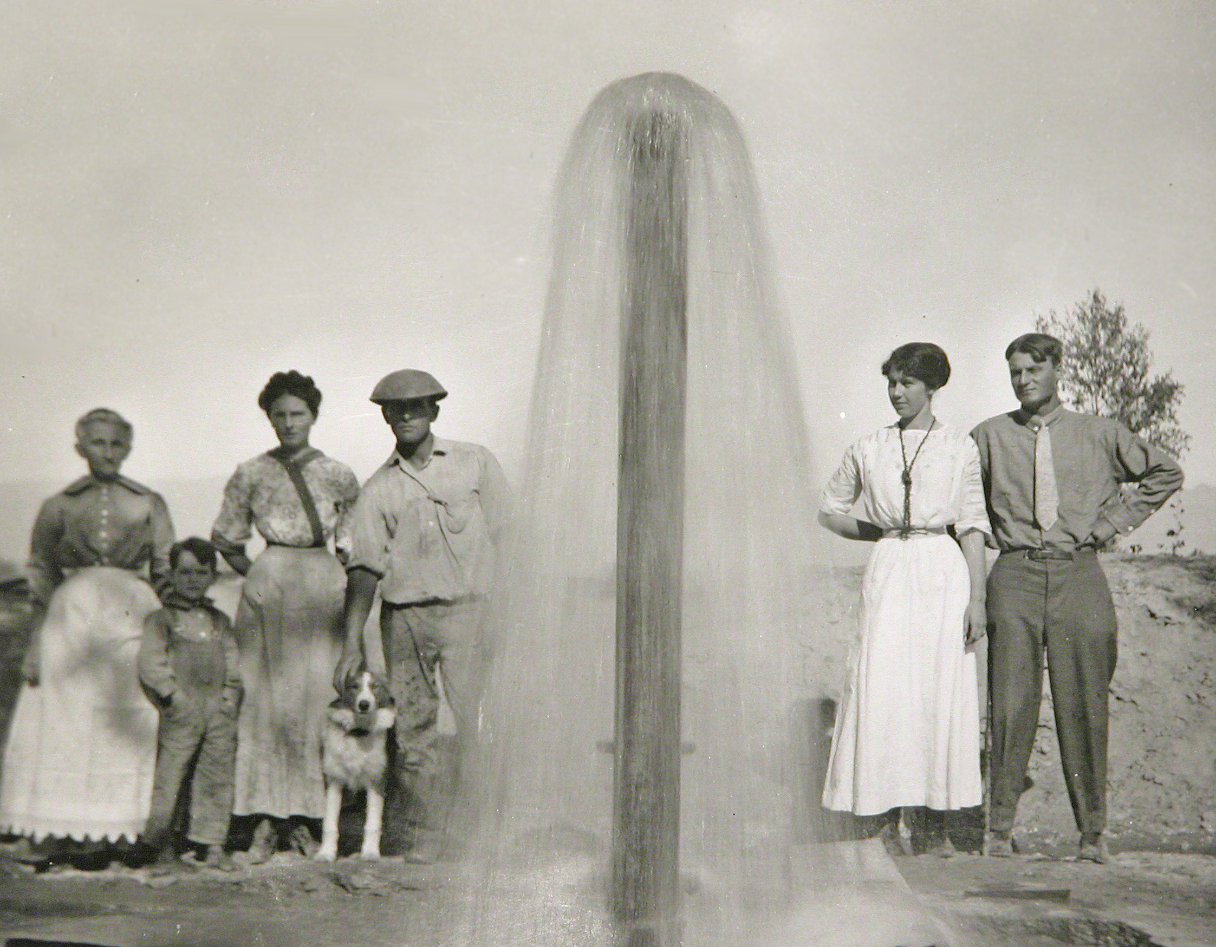
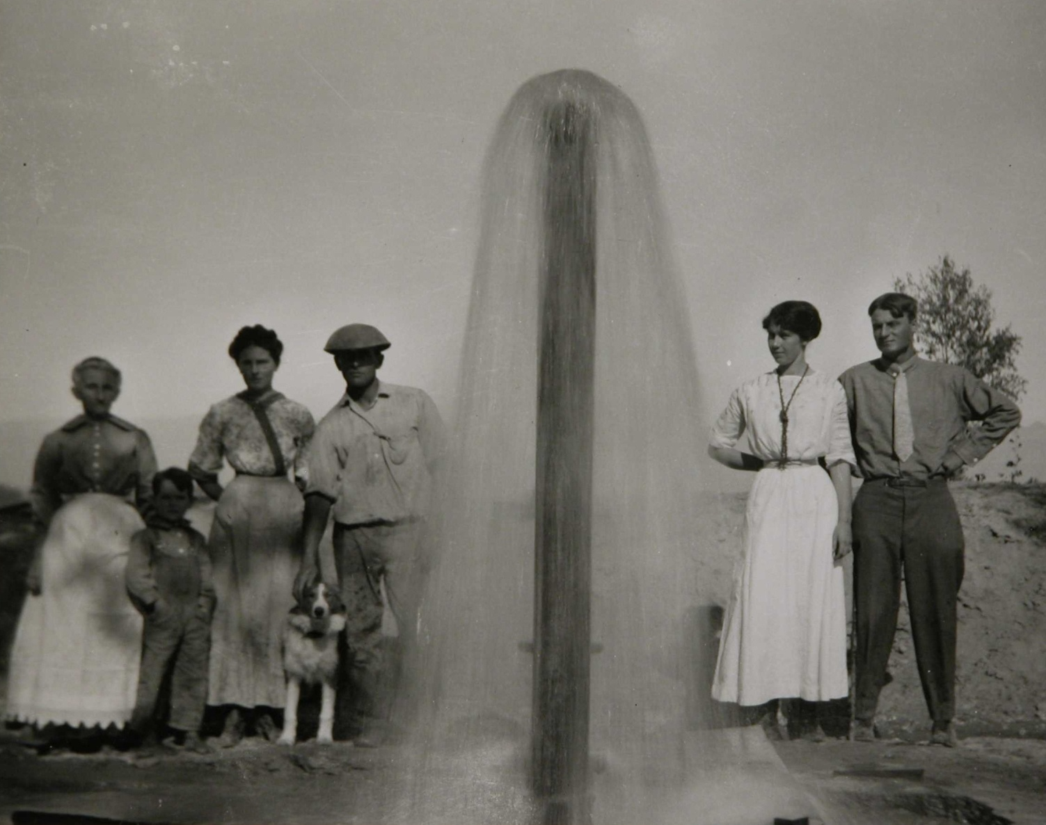
East Valley
Brackish Perched Water Table: 200 ft.
CLAY LAYER: 300 ft.
DEEP PRESSURIZED CONFINED AQUIFER

Slide 11
Federal

Slide 12
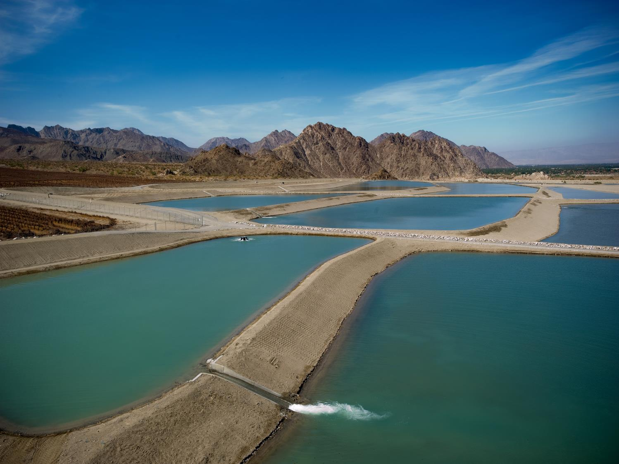
Federal East Valley
Thomas E. Levy Groundwater
Replenishment Facility, La Quinta

Slide 14
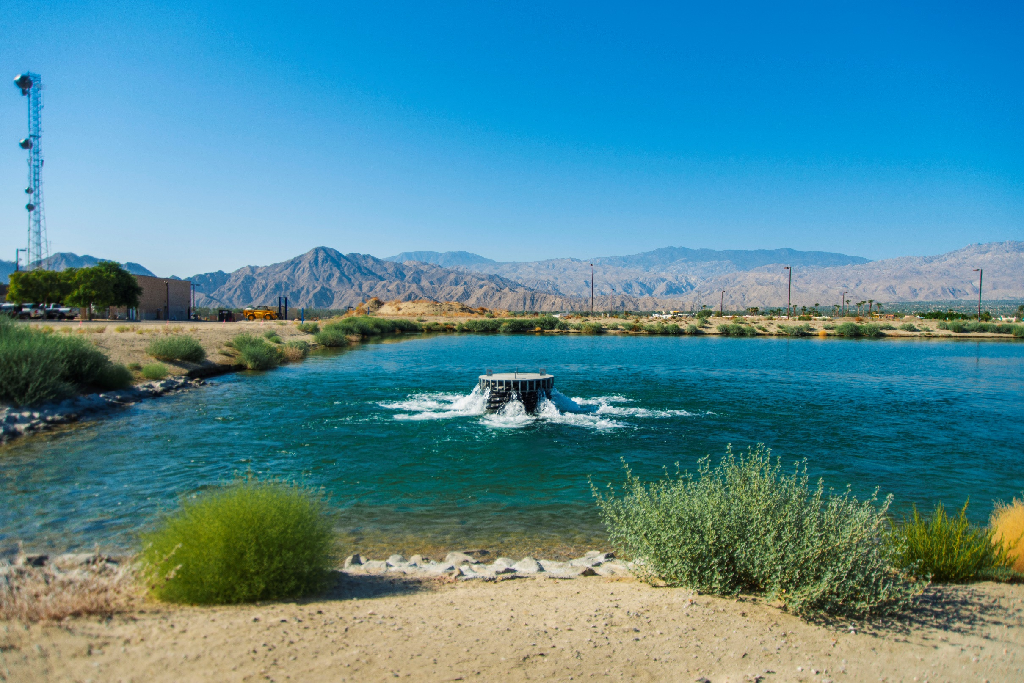
Federal Mid-Valley
Mid-Valley Groundwater Replenishment
Facility, Palm Desert

Slide 15
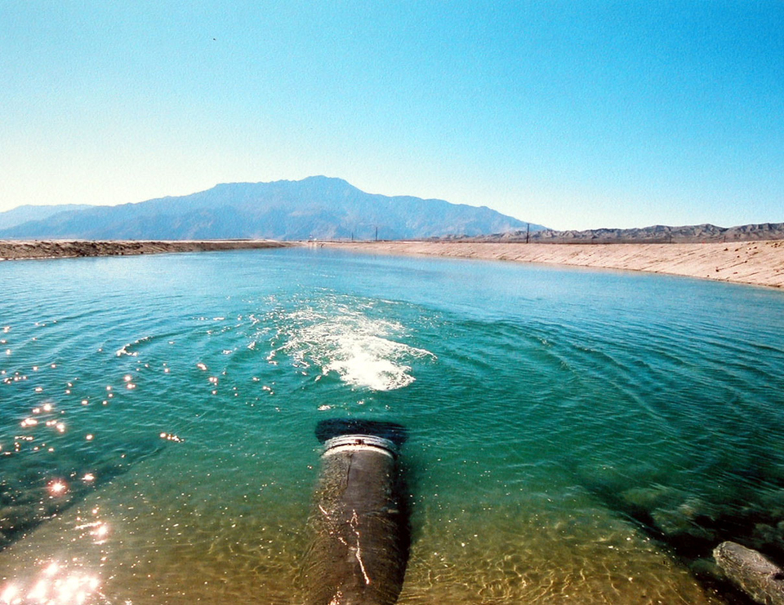
State West Valley
Mission Creek Groundwater
Replenishment Facility,
Desert Hot Springs

Slide 16
State West Valley

Slide 17
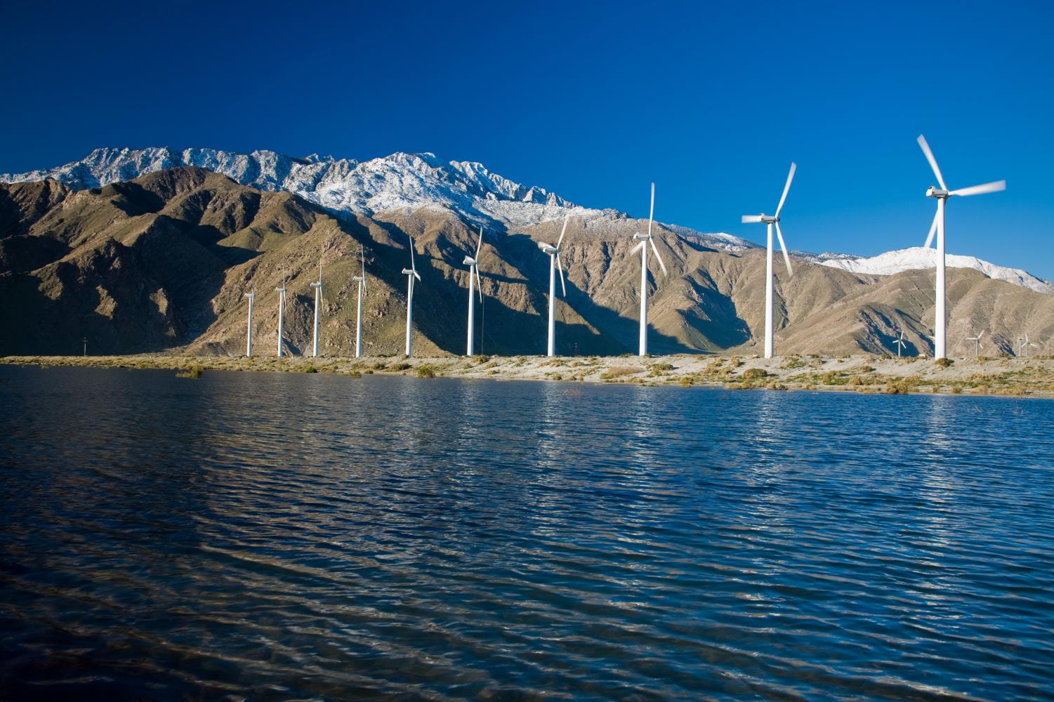
State West Valley
Whitewater Groundwater Replenishment
Facility, Windy Point

Slide 18
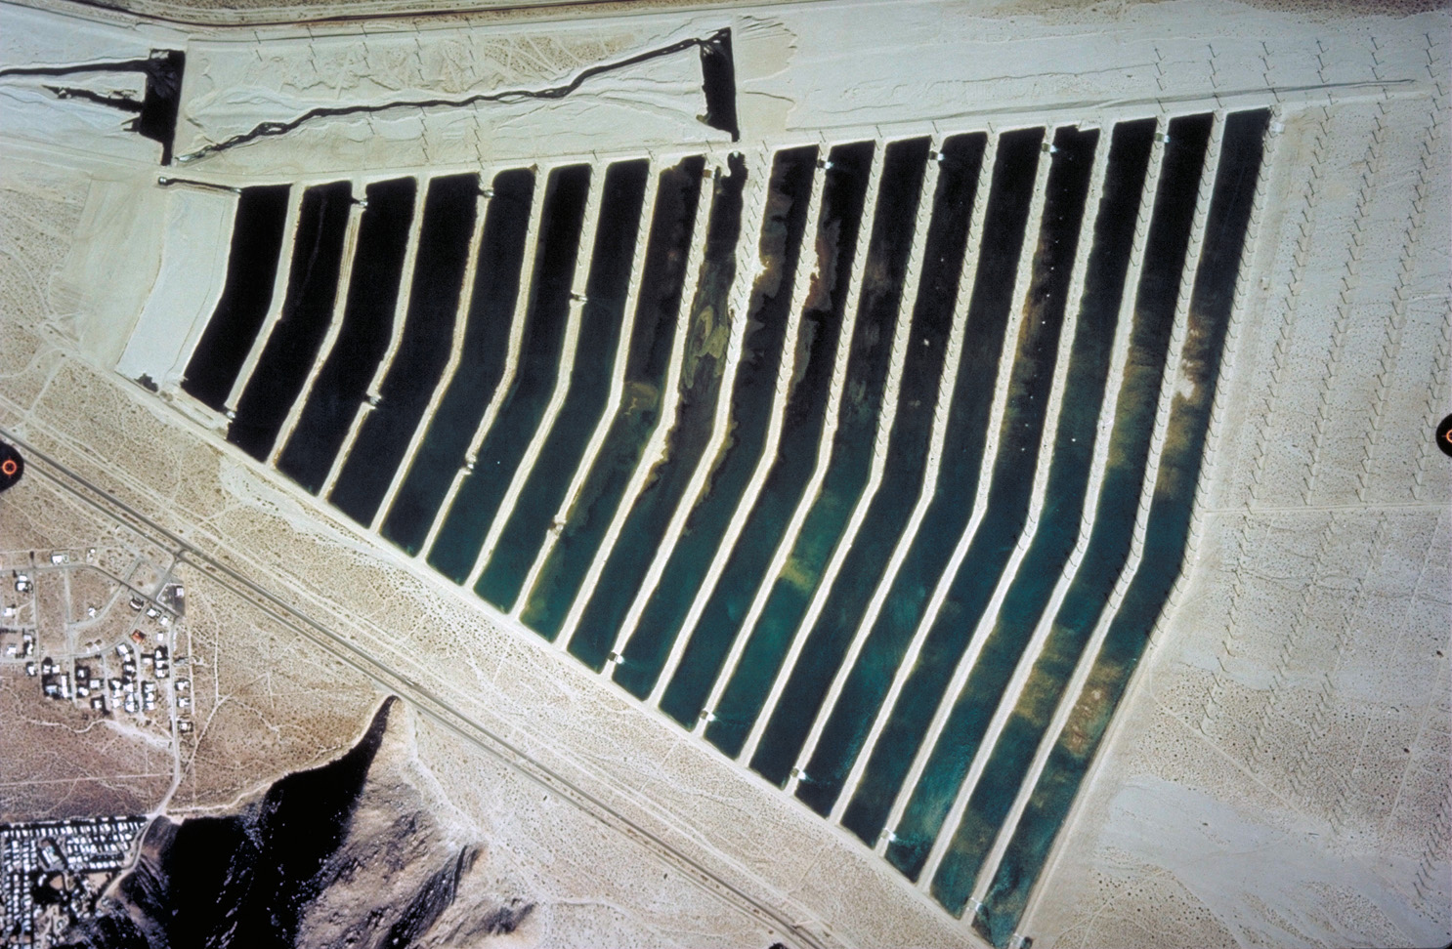
State West Valley

Slide 19
Let’s take a look at the subbasins

Slide 20
San Berardino Mountains
4
4
4
Subbasins of the Coachella Valley Groundwater Basin
Little San Berardino
Whitewater River Subbasin**
Mission Creek Subbasin
San Gorgonio Pass Subbasin
Mountains
$!"`
Banning Fault
4
4
4
4
4
4
4
4
4
4
4
4
4
4
4
4
4
4
4
4
4
4
4
4
Blue C₄ut Faul₄t
4
4
4
Desert Hot Springs Subbasin
4
4
4
4
4
4
4
4
4
Mission Creek Fault
4
4
4
Colorado
Coachella Valley Water District
River
Desert Water Agency
ÌA
Indio Fault
Aqueduct
¦A
San Jacinto Mountains
Quaternary Fault Traces
<150 Yrs
Whitewater River
<750,000 Yrs
<1,600,000 Yrs
San Jancinto Fault
Stormwater Channel
<15,000 Yrs
<130,000 Yrs
4
San Andreas
Mecca Hills
!"`$
4
* - The northern reach of the Whitewater River is referred to as the Whitewater River Stormwater Channel. The southern 23-mile reach is referred to as the Coachella Valley Stormwater Channel.
A¦
Santa Rosa Mountains
Coachella Valley
4
Stormwater Channel
** - The subbasin is indentified as the Indio Subbasin by DWR and the Whitewater River Subbasin by the USGS. This report will identify it as the Whitewater River Subbasin.
Fault Zone
4
4
4
4
4
4
4
4
4
4
. San Bernardino County
Salton Sea
Coachella
ªA
³A
ÌA
Canal
Palm O
Springs
Riverside County
4
4
4
San Diego County
Imperial County
0
5
10
15
20
Coachella Valley Groundwater Basin
Author: CS Date: 4/8/2019
File: Figure 1-1.mxd
Miles
2019-2020 Engineer’s Report
of Water Supply and Replenishment Assessment
10
20
30
KM
Figure 1-1

Slide 21
116°20'0"W
+20 ft
Little San
Increase
+10
Change in Groundwater Elevation*
Berardino Mountains
0
0
34°0'0"N
Decrease
-10
Mission Creek
"/_{!(}
k Water-level data not available in these areas
*Data sourced from Mission Creek Subbasin Annual Report for Water Year 2017-2018 (Wood, 2019)
k
10
5
0
Wells with Hydrographs in Figure 3-3
!(
02S04E21H01S
03S05E17J01S
03S05E19B01S
03S04E12F01S
0
Colorado River
#*
0
#*
WX
#*
#*
Mission Creek Fault
4
4
4
4
WX
Aqueduct
4
4
Replenishment Infrastructure
"6 Direct Replenishment Facilities
"/
Whitewater River
Indio Hills
")
Water Reclamation Plants
k
Imported Water Canals/Aqueducts
N:\MapDocs\Clients\Coachella VWD\2019-2020 Engineers Report\Figure 3-1.mxd
Whitewater River
Banning Fault
Mission Creek Subbasin Management Area
Stormwater
Coachella Valley Water District Areas of Benefit
ÌA
Mission Creek Subbasin AOB
West Whitewater River Subbasin AOB
East Whitewater River Subbasin AOB
Channel
")
WRP 7
Change in Groundwater Elevation in the Mission Creek Subbasin
Management Area
WY 2017 to 2018
Prepared by:
0
1
2
3
4
5
Author: LH Date: 20190320
File: Figure 3-1.mxd
Miles
2019-2020 Engineer’s Report
of Water Supply and Replenishment Assessment
0 1 2 3 4 5
Kilometers

Slide 22
116°20'0"W
+20 ft
Increase
+10
Change in Groundwater Elevation*
Little San Berardino Mountains
0
0
34°0'0"N
Decrease
-10
Mission Creek
"/_{!(}
k Water-level data not available in these areas
*Data sourced from Mission Creek Subbasin Annual Report for Water Year 2017-2018 (Wood, 2019)
k
5
10
15
Wells with Hydrographs in Figure 3-3
20
!(
02S04E21H01S
03S05E17J01S
03S05E19B01S
03S04E12F01S
15
15
10
Colorado River
#*
10
#*
WX
#*
5
Mission Creek Fault
4
4
4
4
WX
#*
Aqueduct
4
4
Replenishment Infrastructure
"6 Direct Replenishment Facilities
"/
Whitewater River
Indio Hills
")
Water Reclamation Plants
k
Imported Water Canals/Aqueducts
Whitewater River
Mission Creek Subbasin Management Area
Coachella Valley Water District Areas of Benefit
Banning Fault
ÌA
Stormwater
Mission Creek Subbasin AOB
West Whitewater River Subbasin AOB
East Whitewater River Subbasin AOB
Channel
")
WRP 7
Change in Groundwater Elevation in the Mission Creek Subbasin
Management Area
WY 2008 to 2018
Produced by:
0
1
2
3
4
5
Author: LH Date: 20190320
File: Figure 3-2.mxd
Miles
2019-2020 Engineer’s Report
of Water Supply and Replenishment Assessment
0 1 2 3 4 5
Kilometers

Slide 23
116"40'0"W
116"20'0"W
Increase t
+100 ft
Change in Groundwater Elevation*
Decrease!
* Water-level data not available in these areas
-100
""Data sourced from Indio Subbasin Annual Report for Water Year 2017-2018 (Stantec, 2019)
Wells with Hydrographs in Figure 4-3
0
03S04E20F01S
04S05E05K01 S
04S05E36M01 S
04S06E22C01 S
05S06E11B01S
05S06E11B01S
♦
....
■
.A.
◊
Replenishment Infrastructure
Direct Replenishment Facilities
Water Reclamation Plants Imported Water Canals/Aqueducts Mid-Valley Pipeline
_{D} West Whitewater Subbasin Management Area
Coachella Valley Water District Areas of Benefit
Mission Creek Subbasin AOB
D
_{D} West Whitewater River
Subbasin AOB
_{D} East Whitewater River
Subbasin AOB
l
Change in Groundwater Elevation in the West Whitewater River
Management Area
WY 2017 to 2018
- -
WEI
Author : EM
0
2 3
4
5
Miles
2019-2020 Engineer 's Report
Date: 20190320
I Kilometers
of Water Supply and
File: Figure 4-1.mxd
0 1 2 3 4 5
Replenishment Assessment
Figure 4-1
WILDERMLJTH ENVIRONMENTAL. IN C.

Slide 24
Increase
t
+100 ft
Change in Groundwater Elevation*
"' -.,_
De cre ase !
* Water-level data not avail able in these areas
:--...
-100
""Da t a sourced from Indio Subbasin Annual Repo rt for Water Year 2017-201 8 (Stantec, 2019 )
/ - ' \
I
I \
'l--i I I
··=-· ,.,<::> /
Wells with Hydrographs in Figure 4-3
\ "'•.,>:0:, I
0
03S04E20F01S
04S05E05K01 S
04S05E36M01 S
04S06E22C01 S
05S06E11B01S
05S06E11B01S
l ,'/ r' ">:_...,.)>
rl \ I > ........
^{1_ -},.,' \ ⁻4-
♦
..........
....
,,_
\ <----
'"
...
.I - ,,.-.
-- :\'i),'.t{,;,
\'\ 1-}/
I J I ,_':::::-_;/fr-\
\_,,..._.,/_,.,'/-,
,._ 0-/ ..... _r,}
r,.-,
r
■
.A.
◊
Replenishment Infrastructure
Direct Replenishment Facilities
Water Reclamation Plants Imported Water Canals/Aqueducts Mid-Valley Pipeline
_{D} West Whitewater Subbasin Management Area
Coachella Valley Water District Areas of Benefit
Mission Creek Subbasin AOB
D
_{D} West Whitewater River
Subbasin AOB
_{D} East Whitewater River
Subbasin AOB
l
Change in Groundwater Elevation in the West Whitewater River
Management Area
WY 2008 to 2018
Produced by:
- -
WEI
Author: LH
0
2 3
4
5
Miles
2019-2020 Engineer's Report
Date: 20190320
I Kilometers
of Water Supply and
File: Figure 4-2.mx d
0 1 2 3 4 5
Reple nishment Asse ssment
Figure 4-2
WILDERMLJTH ENVIRONMENTAL. IN C.

Slide 25
116°20'0"W
116°0'0"W
+15 ft
Increase
Change in Groundwater Elevation*
Indio Fault
0
Whitewater River
WRP 7
")
Decrease
-15
k Water-level data not available in these areas
*Data sourced from Indio Subbasin Annual Report for Water Year 2017-2018 (Stantec, 2019)
Stormwater Channel
XW
-6
Colorado
)"
WRP 10
-4
-2
-2
2
Groundwater Replenishment Infrastructure
-2
0
Coachella Valley
River
Aqueduct
-2
0
2
33°40'0"N
0
-4
$"!`
"6
Groundwater Replenishment Facilities
Water Reclamation Plants Imported Water Canals/Aqueducts Mid-Valley Pipeline
0
-2
Mecca Hills
4
0
-4
#
Stormwater
")
-4
-4
A¦
Santa Rosa Mountains
-6
"/
!(
-2
WRP 4
-2
2
TEL
-4
")
4
Channel
Wells with Hydrographs in Figure 5-3
k
2
-2
")
WX
#
!(
0
05S07E08Q01S
"/
0
WRP 2
")
06S08E19R01S
#*
")
-4
2
Coachella
Canal
4
k
0
2
0
07S07E03D01S
07S08E32A01S
0
Fault Zone
#*
Martinez Canyon
07S08E35D01S
2
Salton Sea
)"
")
07S09E18H01S
4
4
4
ÌA
Coachella Valley Water District Areas of Benefit
k
Mission Creek Subbasin AOB
³A
West Whitewater River Subbasin AOB
East Whitewater River Subbasin AOB
Change in Groundwater Elevation in the East Whitewater River
Subbasin AOB
WY 2017 to 2018
Produced by:
Author: EM Date: 20190312
File: Figure 5-1.mxd
Miles
2019-2020 Engineer’s Report
of Water Supply and Replenishment Assessment
Kilometers

Slide 26
116°20'0"W
116°0'0"W
+100 ft
er
Increase
Change in Groundwater Elevation*
Indio Fault
0
Whitewater River
WRP 7
-8
Decrease
")
-100
-4
k Water-level data not available in these areas
*Data sourced from Indio Subbasin Annual Report for Water Year 2017-2018 (Stantec, 2019)
4
Stormwater Channel
WX
0
4
Colorado
)"
WRP 10
0
0
10
8
Coachella
10
4
0
8
River
Groundwater Replenishment Infrastructure
10
20
Aqueduct
33°40'0"N
20
8
!"`$
"6
Groundwater Replenishment Facilities
Water Reclamation Plants Imported Water Canals/Aqueducts Mid-Valley Pipeline
20
30
20
Valley
10
Mecca Hills
4
20
40
#
")
90
Stormwater
¦A
Santa Rosa Mountains
"/
!(
WRP 4 ")
20
4
TEL
80
70
60
30
20
Wells with Hydrographs in Figure 5-3
k
20
WX
#
!(
Channel
")
40
05S07E08Q01S
"/
40
Coachella
06S08E19R01S
k
#*
30
)"
50
WRP 2 ^{")}
Canal
4
07S07E03D01S
07S08E32A01S
20
Martinez Canyon
Fault Zone
#*
Salton Sea
")
07S08E35D01S
")
07S09E18H01S
4
4
AÌ
Coachella Valley Water District Areas of Benefit
k
Mission Creek Subbasin AOB
³A
West Whitewater River Subbasin AOB
East Whitewater River Subbasin AOB
Change in Groundwater Elevation in the East Whitewater River
Subbasin AOB
WY 2008 to 2018
Produced by:
0 1 2 3 4 5
Author: EM Date: 20190312
File: Figure 5-2.mxd
Miles
2019-2020 Engineer’s Report
of Water Supply and Replenishment Assessment
Kilometers

Slide 27
THANK YOU!
QUESTIONS?

