Slide 1

Golf and Nonpotable Water in the Coachella Valley

Slide 2
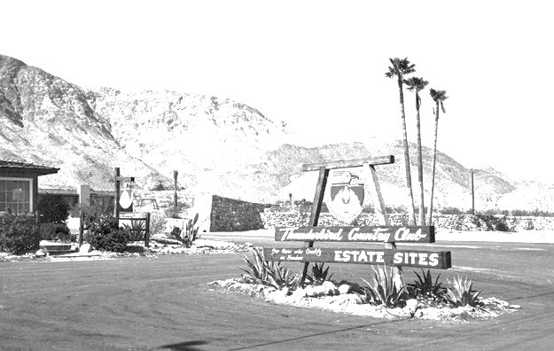
First golf course in the valley…
…was the O’Donnell in 1926, second was Indian Palms (used to be Cochran-Odlum) in 1947, third Thunderbird 1951…
Notes:
Photography courtesy Robert Windeler in Palm Springs Life http://www.palmspringslife.com/Palm-Springs-Life/January-2011/Before-the-Hope/

Slide 3
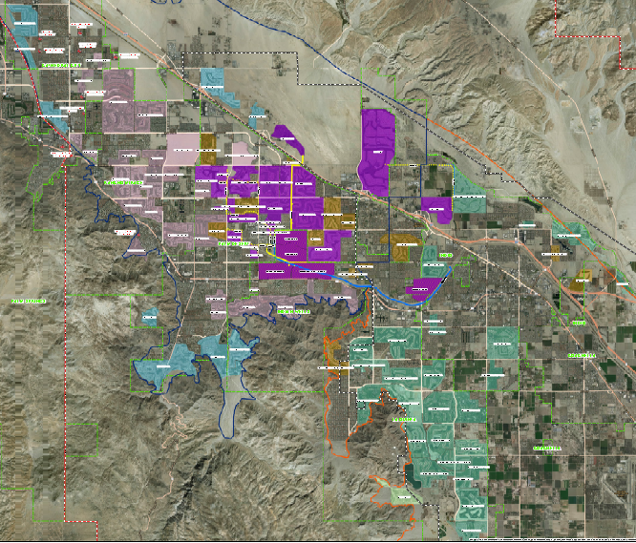
Now, there are 120 golf courses in the valley!

Slide 4
105 of the golf courses are within CVWD’s boundaries.
Canal via Canal distribution system | 29
Future Canal via Canal distribution system | 4.5
Canal via Mid Valley Pipeline | 6
Future Canal via Mid Valley Pipeline | 17
Recycled water/canal | 17.5
Future Recycled water/canal | 17
Not planned for an Alternate Water Supply | 13
Total Golf Courses: | 105
Nonpotable Water Source: | 53
Per Cent Using Nonpotable Water Source: | 50%

Slide 5
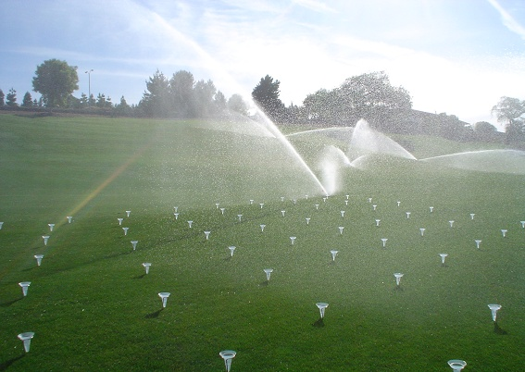
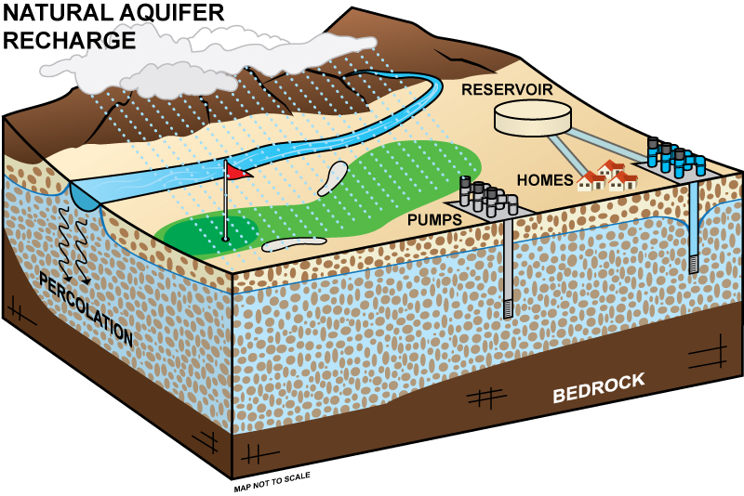
Sources of golf course irrigation water:
Storm water
Ground water
Nonpotable Water

Slide 6
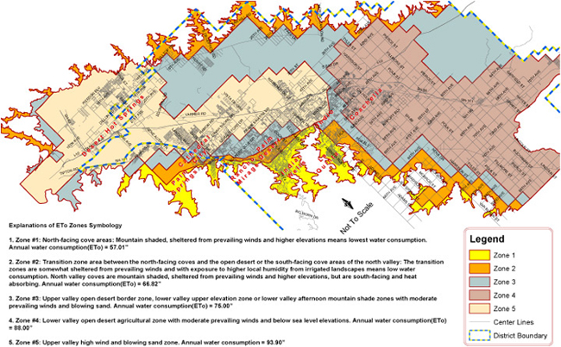
How much water is used by a golf course annually?
It depends primarily on the ETo zone, irrigated acreage and lake area. Anywhere from about 300 AF/Yr for our smaller courses in a protected area to about 1400 AF/Yr for our large courses in the windy areas. Average of 885 AF/Yr.

Slide 7
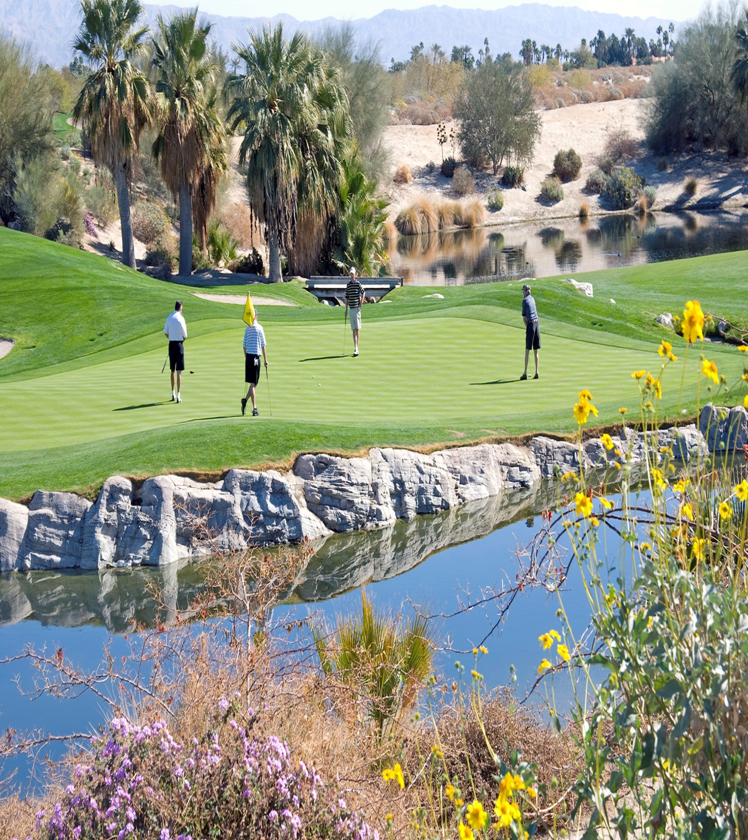
Average water use for a golf course
The average water use on a golf course is around 885 acft/yr.
To make it easy, we round up to say that “a typical golf course uses 1,000 acft per year”.
Golf Courses in the valley use up to 120,000 acft of water per year.

Slide 8
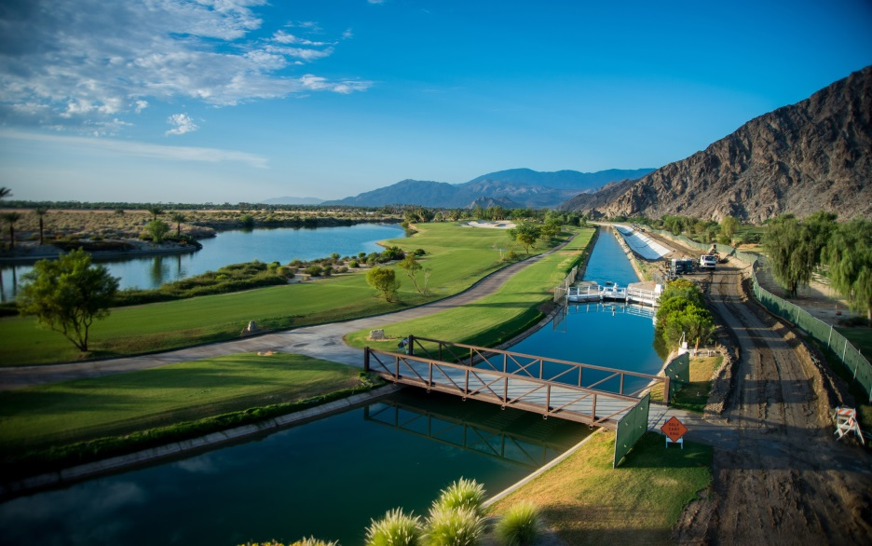
What’s the big deal? Overdraft and subsidence.
Final USGS report published in 2014.
CVWD and USGS study since 1996.
Yellow and red show areas of most subsidence.
Up to 410mm (1.35ft)

Slide 9
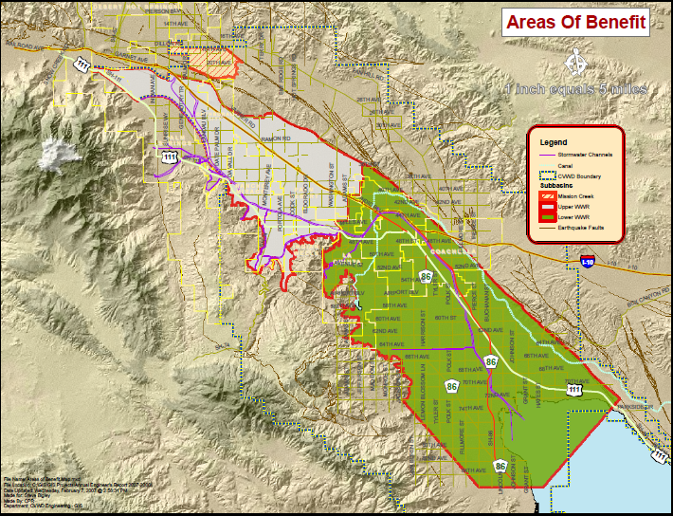
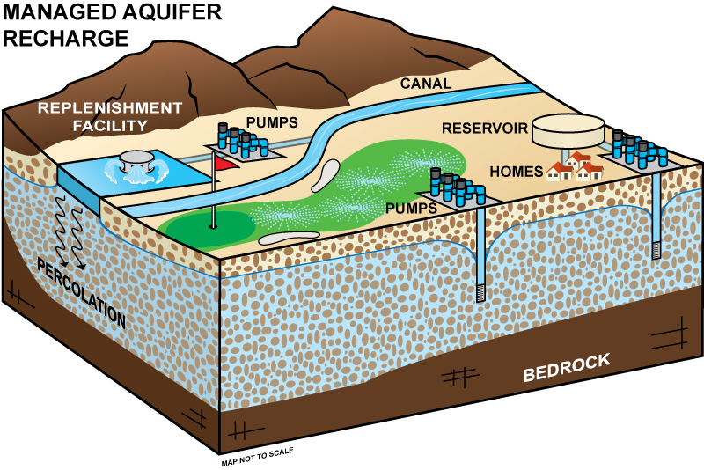
To minimize and eliminate further overdraft, the aquifer has been replenished with imported water.

Slide 10
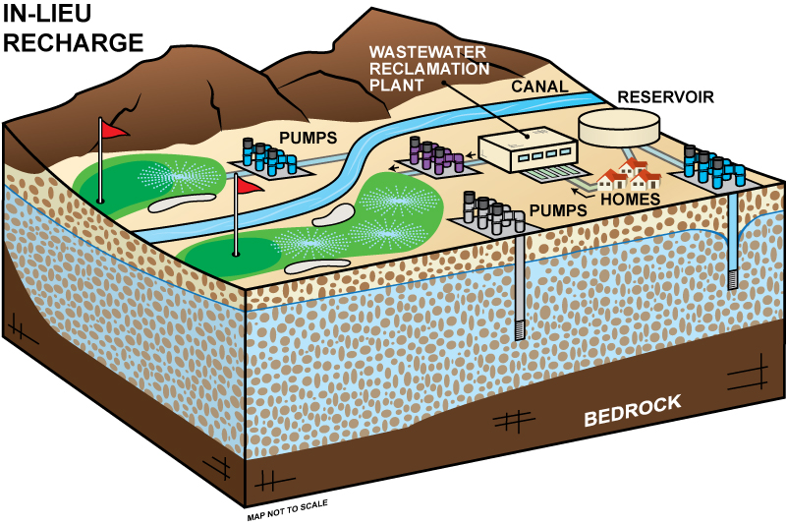
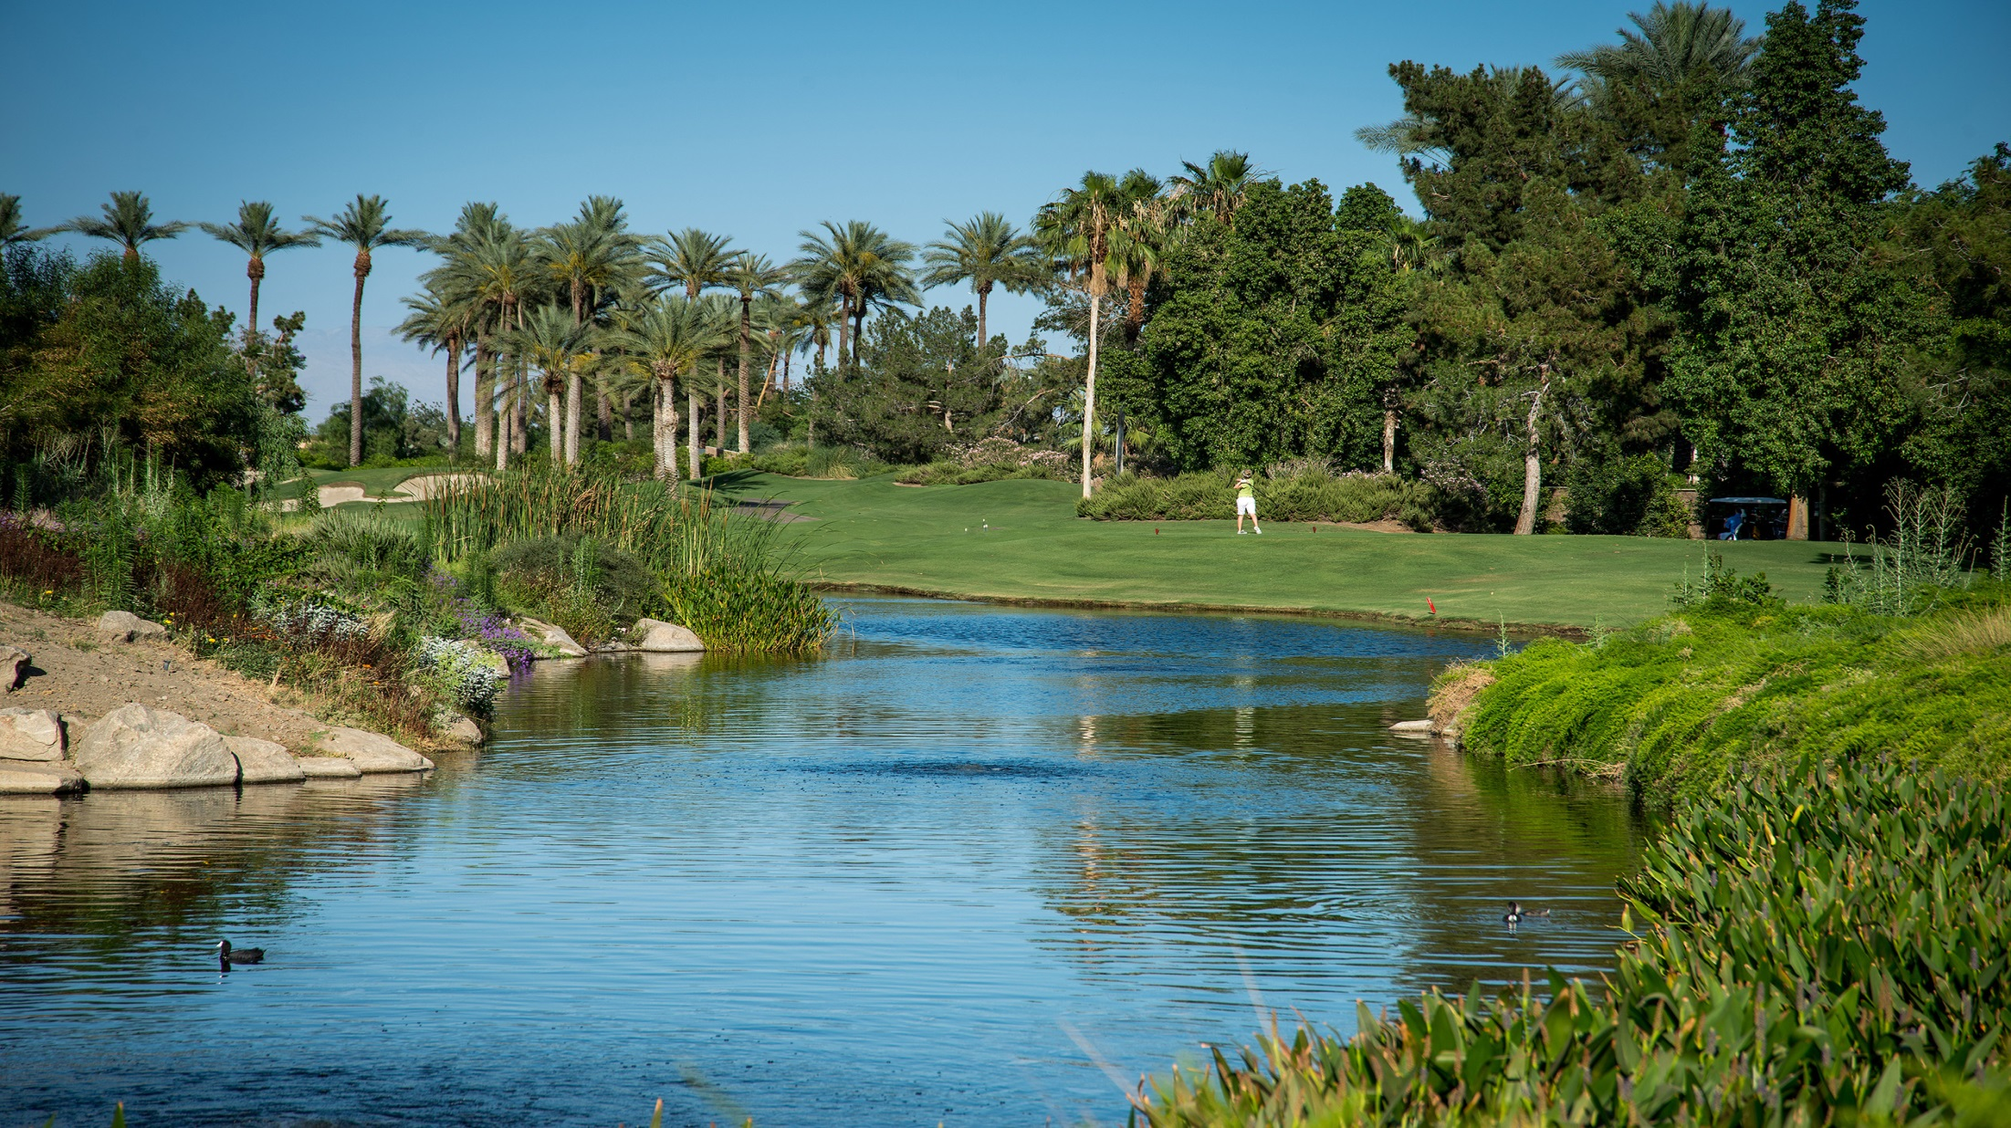
34 golf courses in the mid-valley available for in-lieu recharge opportunities.
Instead of delivering Colorado river water to percolation ponds to replenish the aquifer, an alternate water source (nonpotable water) is delivered to golf courses for irrigation, leaving groundwater in the ground.

Slide 11
Nonpotable Water
Types of nonpotable water for golf courses:
Canal Water (Colorado River)
  -Mid-Valley Pipeline, and
  -Canal water distribution system.
Recycled Water
  -Water Reclamation Plant (WRP7 or WRP10),
  -Tertiary Disinfected Recycled Water
Nonpotable customers irrigate with water that is not deemed safe for drinking. They no longer relying primarily on the groundwater, our potable water source, for nonpotable purposes.

Slide 12
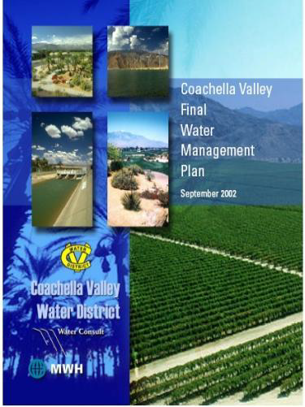
Coachella Valley Water Management Plan
(2002 and 2010 update and 2014 update)
The goal of the CVWMP is to reliably meet current and future water demands in a cost effective and sustainable manner.
Eliminate groundwater overdraft and its associated adverse impacts.
    Storage Loss
    Declining Groundwater Levels
    Land Subsidence
    Water Quality Degradation
Maximize conjunctive use opportunities (includes in-lieu recharge).
Minimize adverse economic impacts to Coachella Valley water customers.
Minimize environmental impacts.

Slide 13
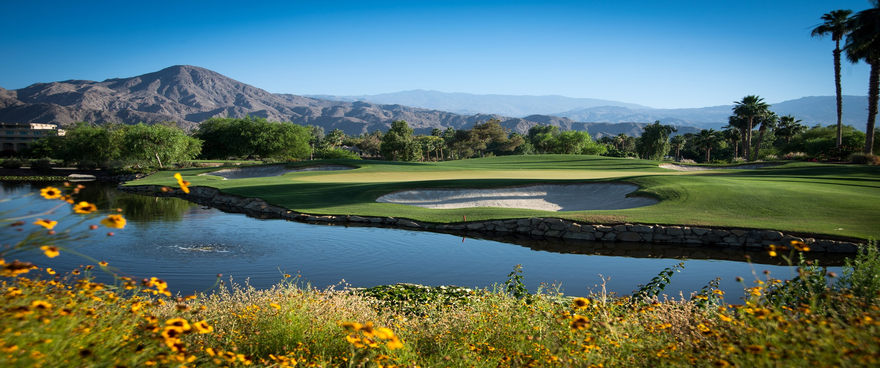
CVWMP objectives for golf courses:
Conservation with improved irrigation systems and techniques and technology. 10%.
Utilize nonpotable water sources for golf courses. In-Lieu recharge projects.

Slide 14
Golf and Water Task Force
Mission Statement
To ensure a sustainable water supply for future generations, to meet if not exceed the goals of the Coachella Valley Water Management Plan, to pursue all feasible water conservation measures, to promote and expedite the use of nonpotable water, and to educate Valley residents regarding the importance of pursuing these goals for the environmental and economic quality of life in the Coachella Valley.

Slide 15
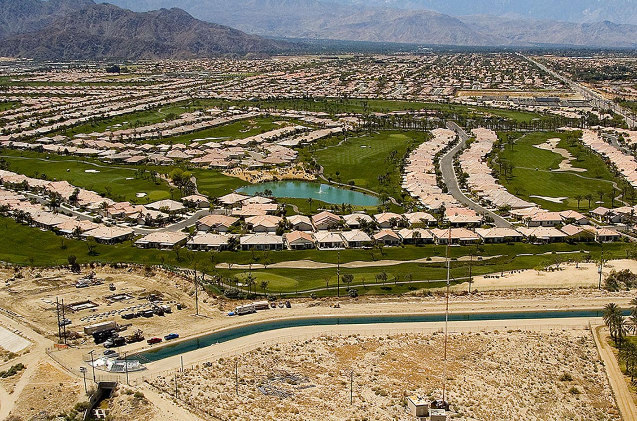
Nonpotable Water for golf courses
East Valley GC’s to Colorado River water:
Goal = 34,500 afy and in 2019 = 17,011 af meeting 69% of total irrigation demand.
Mid Valley NPW connections:
Goal = 52,000 afy and in 2019 = 22,462 af meeting 91% of total irrigation demand.

Slide 16
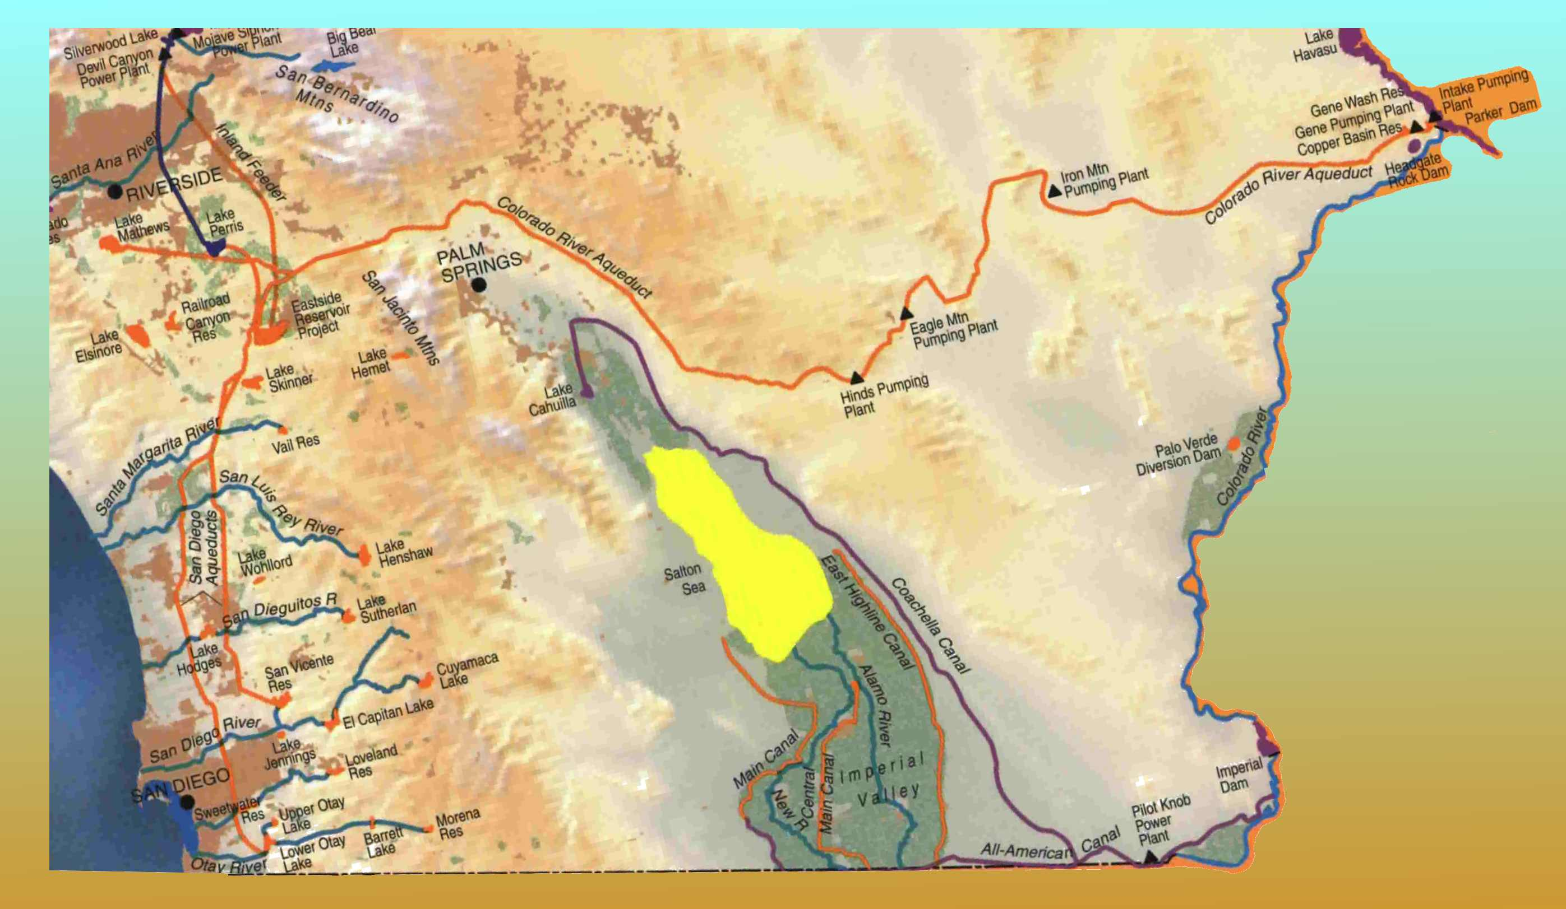
Coachella Canal

Slide 17
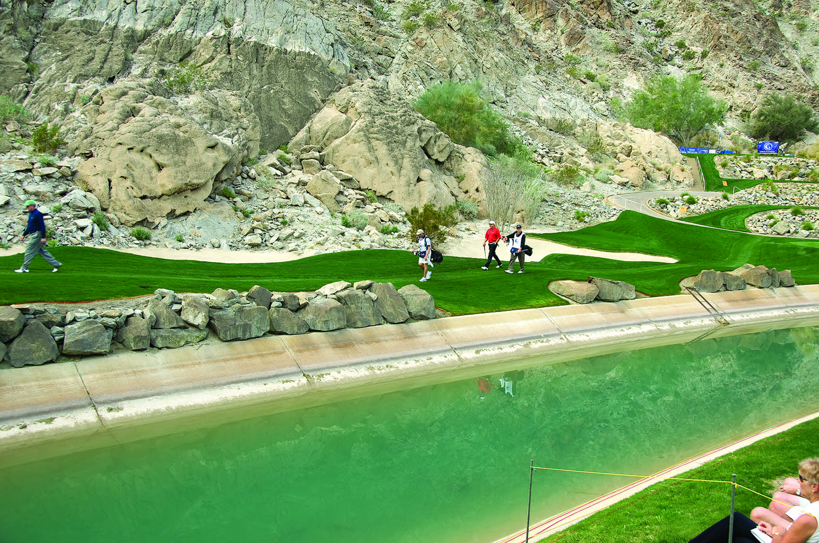
Conversion of golf courses to canal water
The 4.5 remaining conversions are expected to be completed by 2025.

Slide 18
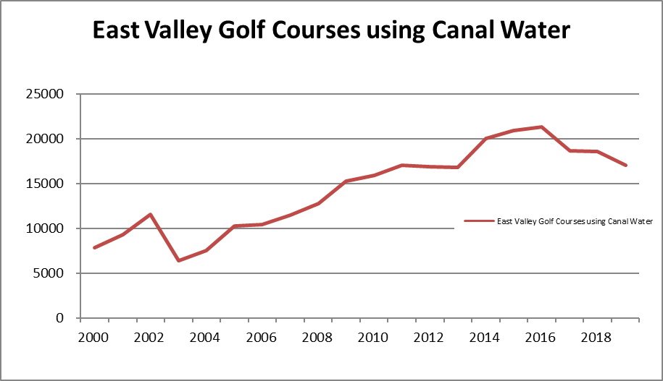
Year | East Valley Golf Courses using Canal Water
2000 | 7884.1
2001 | 9335.6
2002 | 11540.6
2003 | 6385.1
2004 | 7511.3
2005 | 10290.3
2006 | 10395.7
2007 | 11469.7
2008 | 12805.9
2009 | 15282.9
2010 | 15927.8
2011 | 17076.7
2012 | 16873.2
2013 | 16828.6
2014 | 20053.5
2015 | 20883.2
2016 | 21351.8
2017 | 18678
2018 | 18586
2019 | 17011
New Connections :
1988 | PGA West
1994 | Indio Muni
1996 | Plantation
1997 | Traditions
1998 | The Hills (Terra Lago)
1999 | Heritage Palms
2000 | The Palms
2001 | Hideaway
2002 | Trilogy, PGA West Weiskopf
2005 | Silver Rock
2006 | Outdoor Resort, PGA-Norman, Ranch La Quinta, Shadow Hills (front nine)
2007 | Mountain View, Vineyards, Andalusia, Shadow Hills (back nine), Madison
2010 | Indian Palms
2014 | Indian Palms (2nd connection)
2016 | La Quinta CC, La Quinta Resorts Dunes
2020 | La Quinta Resorts Mountain

Slide 19
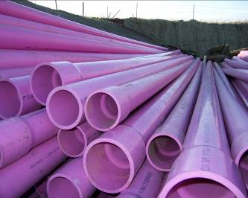
Recycled Water
Recycled water has been a water supply source in the Valley since 1965 at Palm Desert Country Club. CVWD acquired this WRP in 1968.
CVWD has 5 wastewater treatment plants, 2 that provide recycled water for golf course and landscape irrigation.
CVWD delivers disinfected tertiary recycled water for golf course and landscape irrigation.

Slide 20
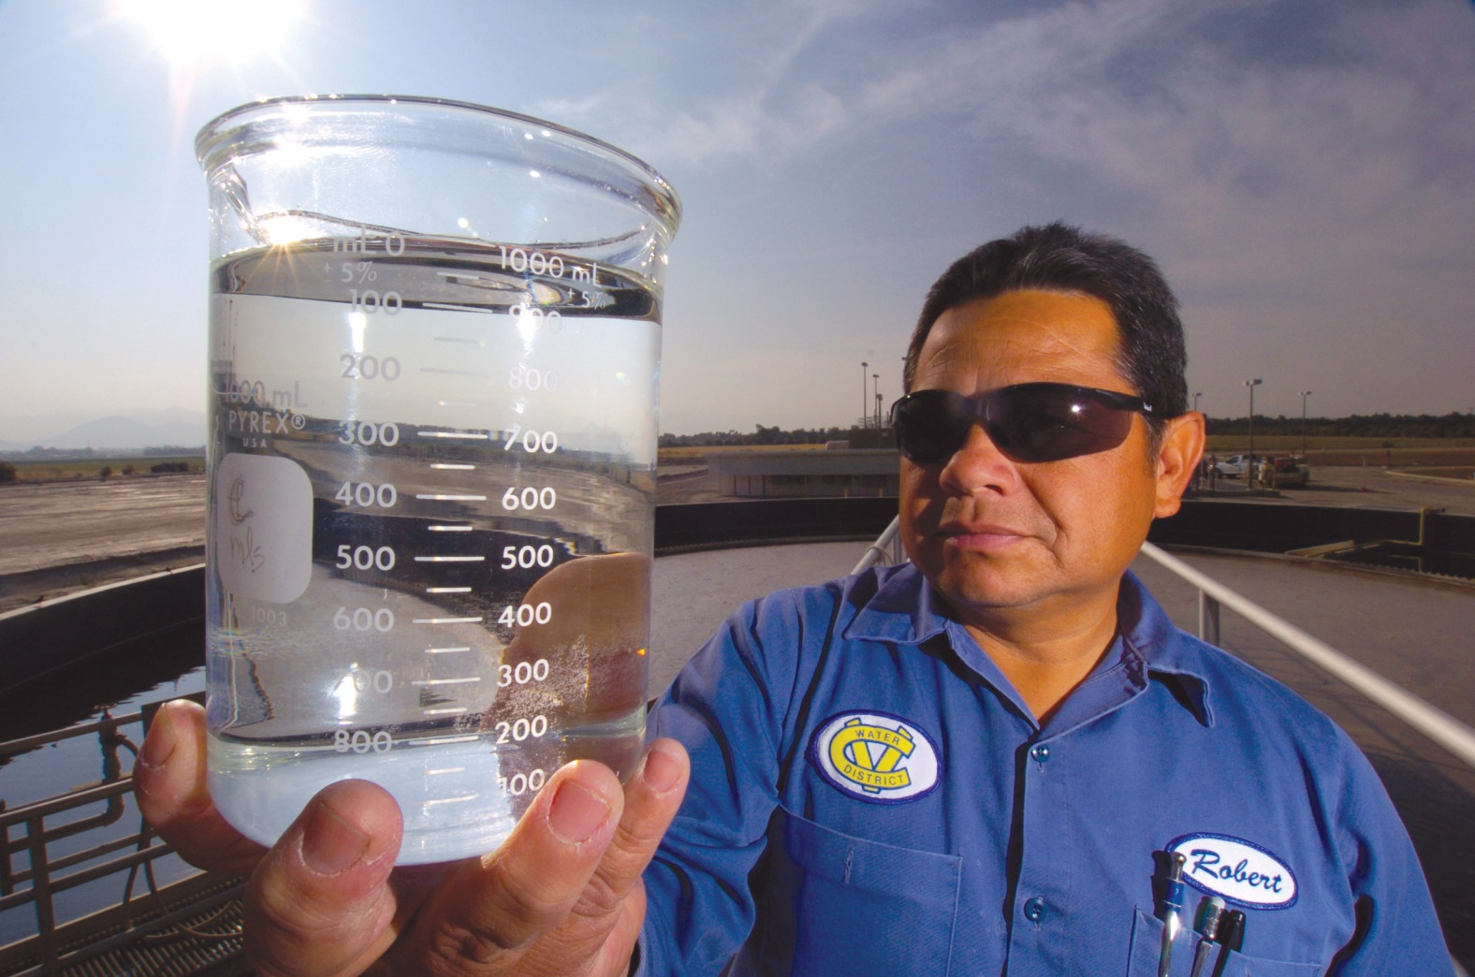
Municipal wastewater collected from homes and businesses that receives a high level of treatment at a water reclamation plant. It is monitored 24/7, water quality samples are collected and tested to ensure permit regulation limitations are met, so that it can safely be beneficially reused. It is no longer considered wastewater.

Slide 21
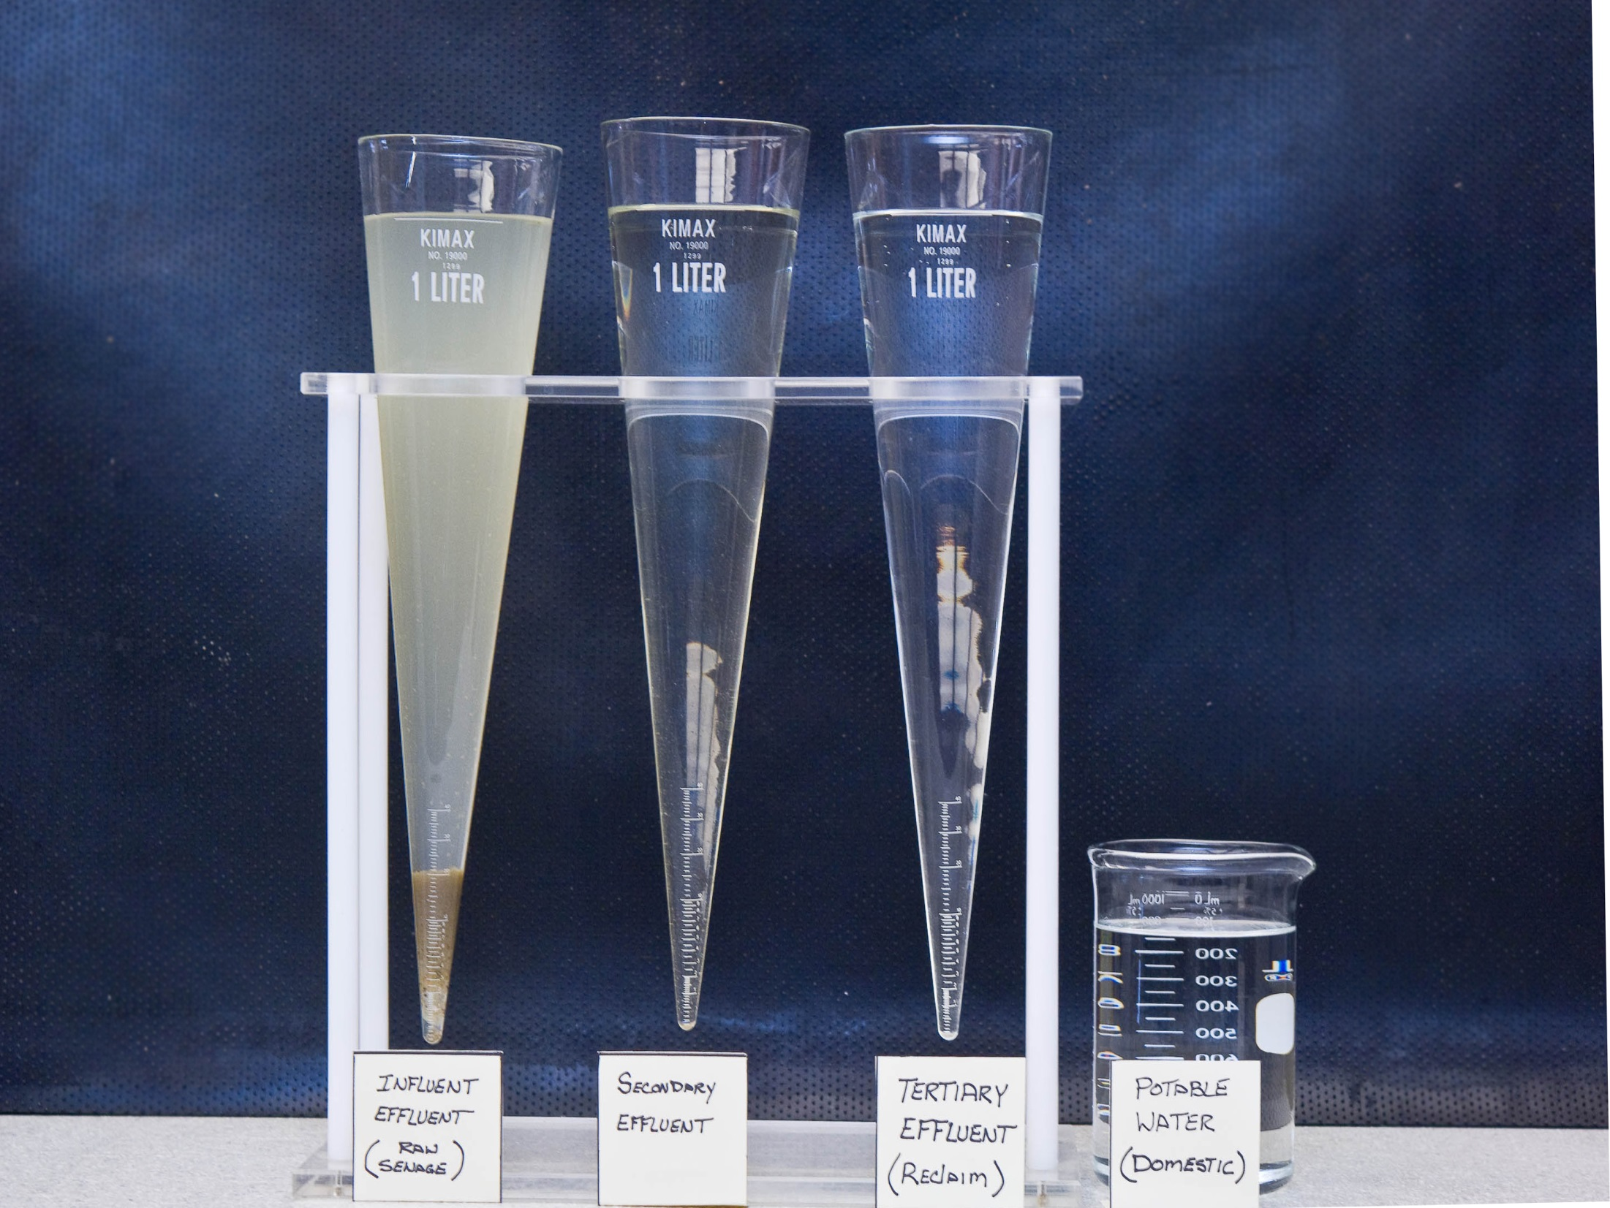

Slide 22
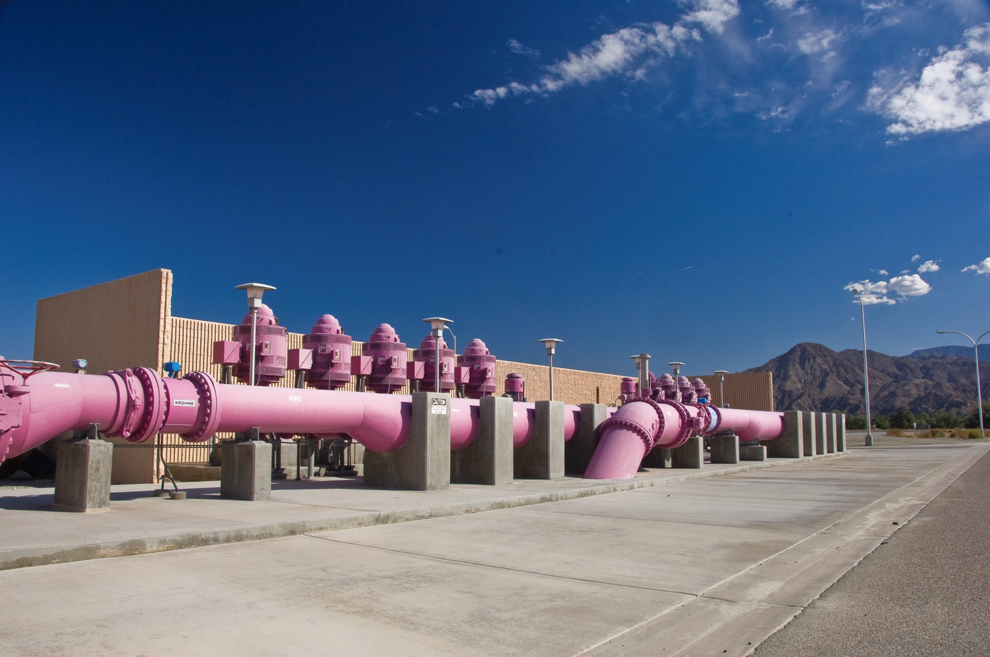

Slide 23

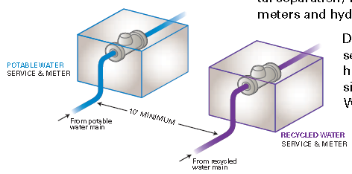
Rules and Regulations
Dos and Don’ts
Training
Permit
Agreement
Purple
Signs
Public notification
Cross-connection Test
Annual Survey
Monitoring and Reporting

Slide 24
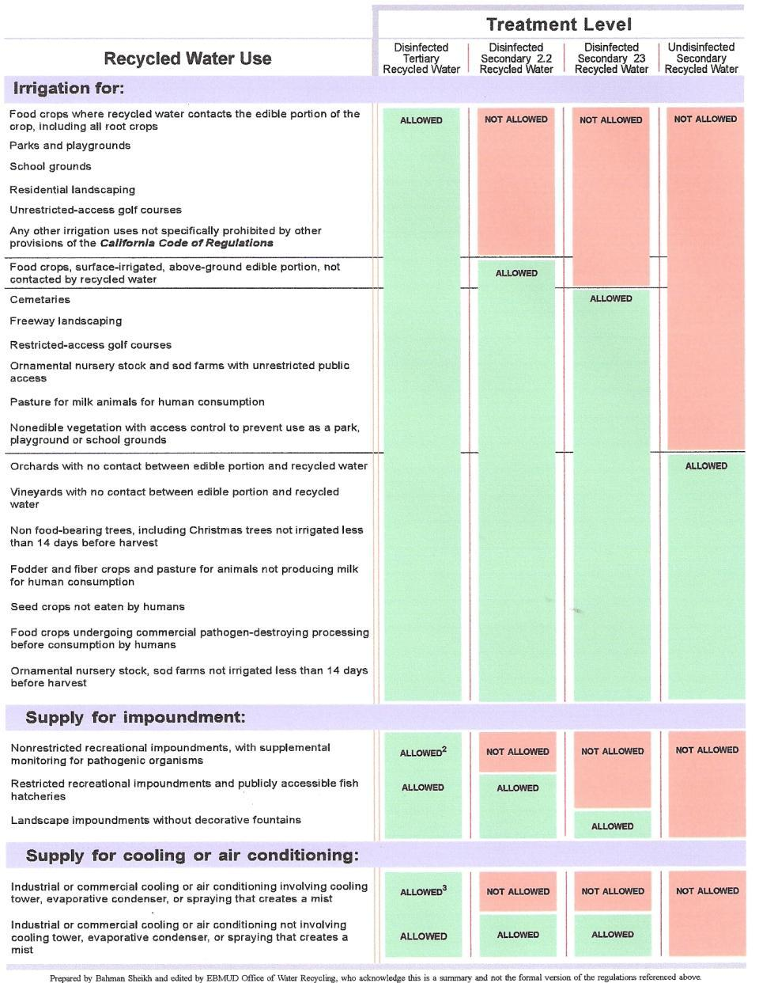
Allowed Uses of Recycled Water

Slide 25
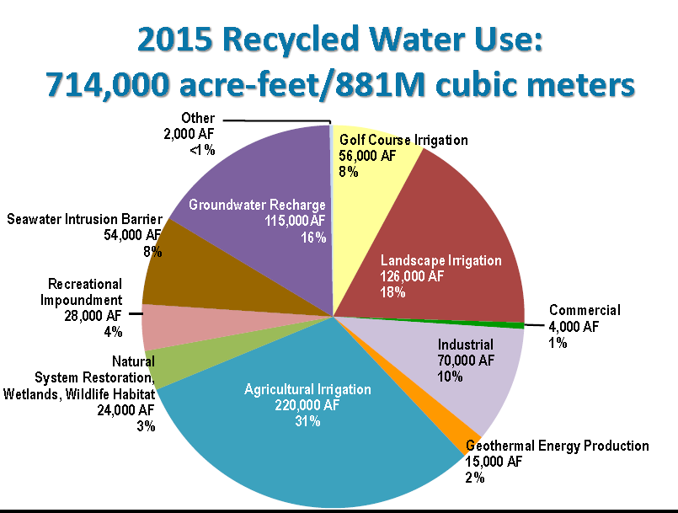

Slide 26
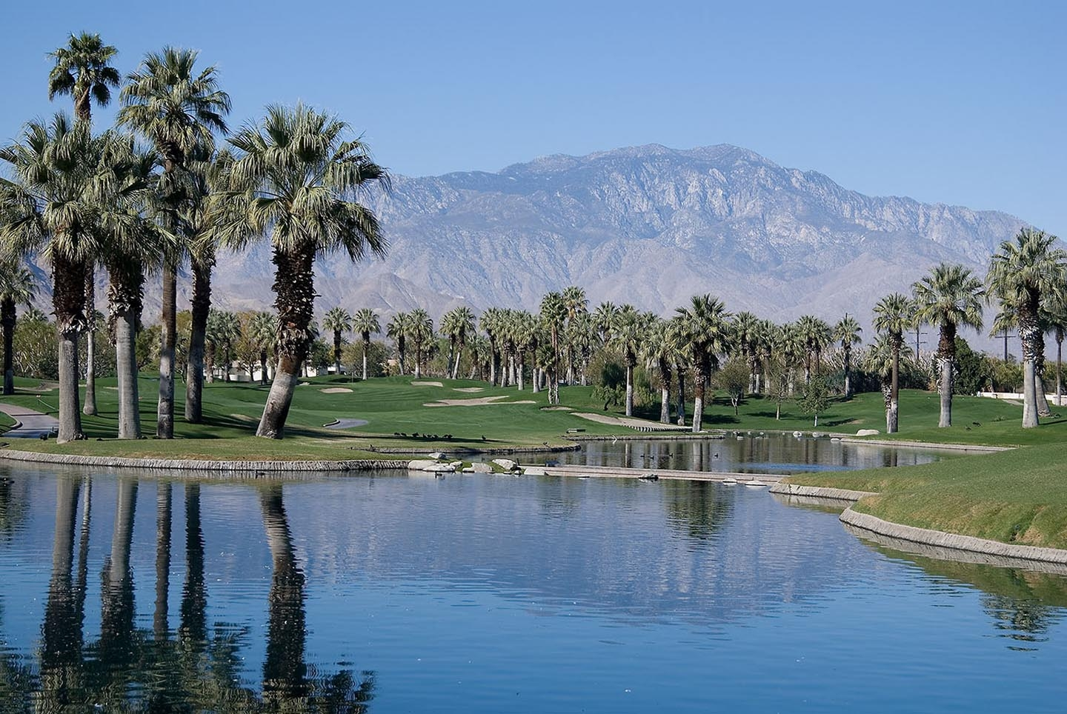
Recycled Water Use in Coachella Valley
Golf Course and landscape irrigation:
Golf Courses
Home-Owner Associations (HOAs)
High-School Athletic Fields
Landscaped areas at CVWD’s Palm Desert offices and WRPs.

Slide 27
Why Do We Recycle Water in Coachella Valley?
CVWD adopted and is implementing the CVWMP to eliminate overdraft, includes source substitution for golf courses.
Irrigating with Recycled water saves groundwater.
Treatment technology can produce a safe recycled water for any given use.
Recycled water is a reliable local water supply for irrigation.
Recycled water percolation is highly regulated and will soon require significant upgrades to the WRP treatment process, unless we find a home for it elsewhere…golf courses.
More affordable to connect golf courses to recycled water than to complete these significant upgrades at the WRP.

Slide 28
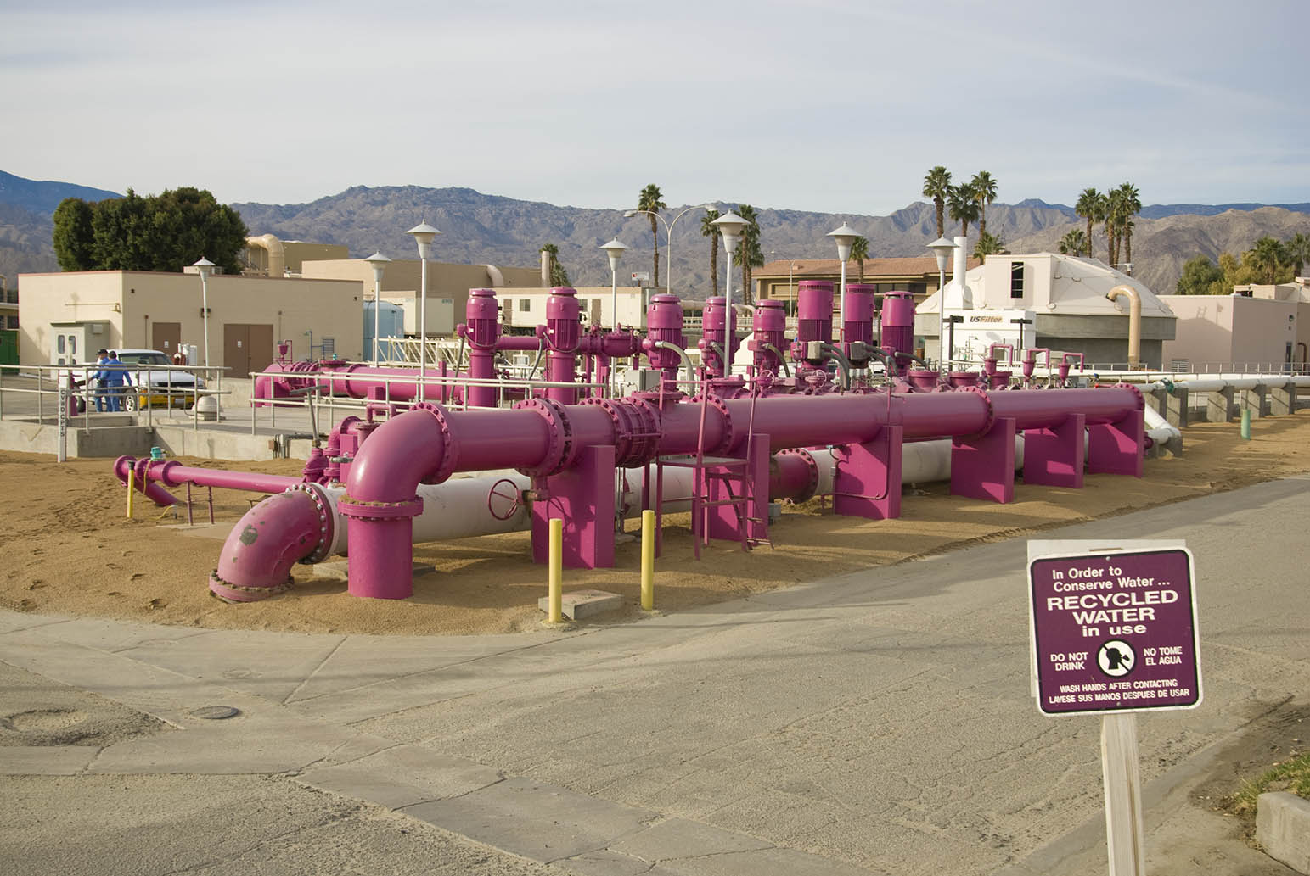
Not enough recycled water
Recycled water supply is not a sufficient water supply for all golf courses in the mid-valley area.
Recycled water supply runs out in the summer and golf courses would supplement with groundwater.

Slide 29
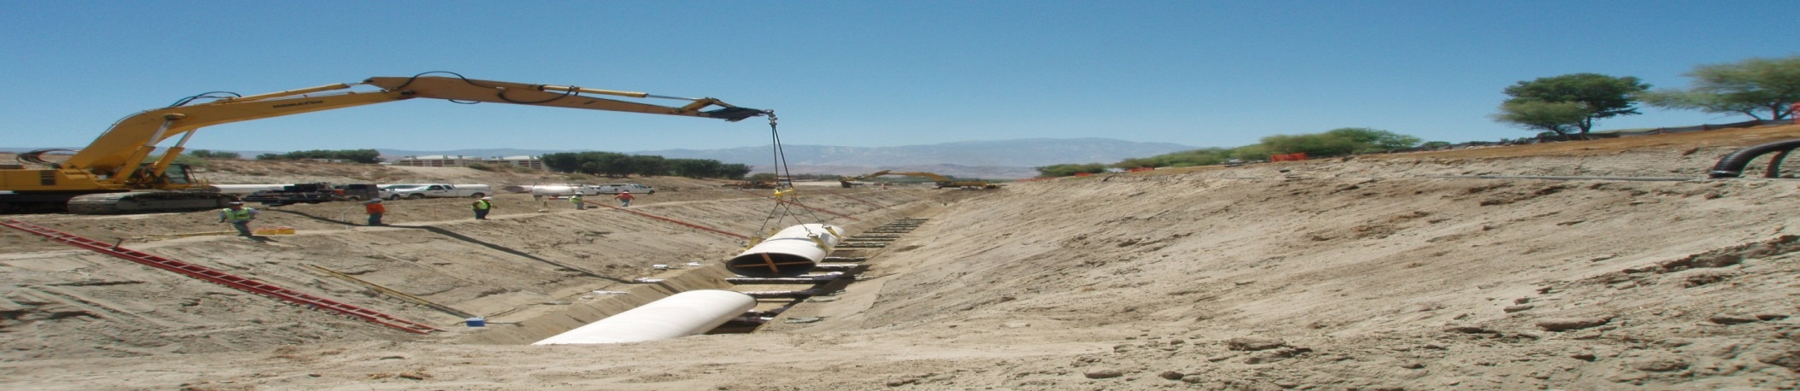
Mid-Valley Pipeline In-Lieu Project
The MVP delivers canal water to WRP10. Completed in 2009. 7 mile, 54” pipeline of welded steel with cement mortar lining in the wash.
Canal water supplements the recycled water supply and provided to golf courses in lieu of their pumping groundwater.
Completion of the MVP system after 2027 to provide up to 37,000 AFY of Canal water and 15,000 AFY of WRP10 recycled water to Mid- Valley golf courses.
In 2019, CVWD provided 22,462 acft of nonpotable water (which includes 8,759 acft of recycled water) to golf courses in the mid-valley area. Meeting 91% of their demand.

Slide 30
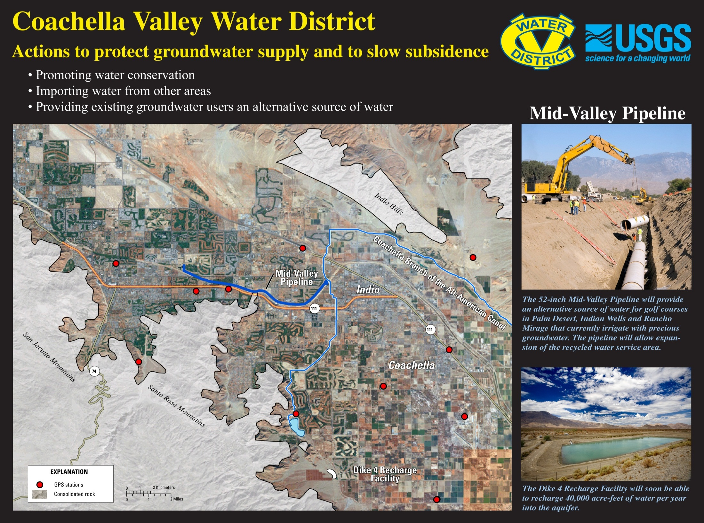

Slide 32
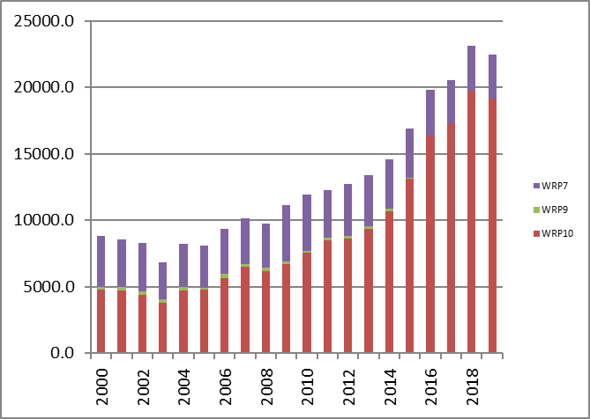
Nonpotable Water use in Mid-Valley
Year | total
2000 | 8831.9
2001 | 8565.2
2002 | 8299.4
2003 | 6844.2
2004 | 8208.9
2005 | 8109.3
2006 | 9342.7
2007 | 10127.0
2008 | 9750.2
2009 | 11162.6
2010 | 11915.5
2011 | 12281.2
2012 | 12756
2013 | 13385
2014 | 14602
2015 | 16876
2016 | 19796
2017 | 20516
2018 | 23139
2019 | 22462
New Connections
1968 | Palm Desert Country Club
1987 | Santa Rosa, Palm Desert Greens, Portola CC
1991 | Golf Center, Marriott Desert Springs, Vista Del Montanas, Silver Sands, Casa Blanca
1992 | West Coast Turf
1993 | Sunrise
1994 | Indian Ridge CC
1996 | Palm Desert High School
1997 | Sun City Palm Desert, Desert Willow
1998 | Mountain View Falls
2006 | Toscana, Shadow Hills
2012 | CVWD's PDA & PDO, Indian Wells Golf Resort
2014 | Classic Club, Palm Desert CC (remaining)
2016 | Desert Horizons, Lakes CC, Avondale
2017 | Desert Falls, Palm Valley Country Club,
2018 | Indian Springs

Slide 33
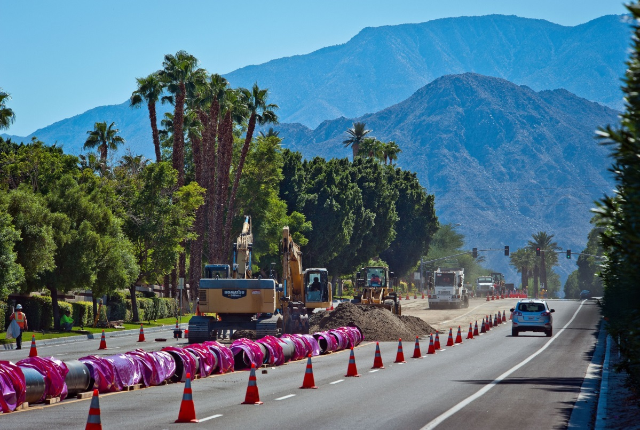
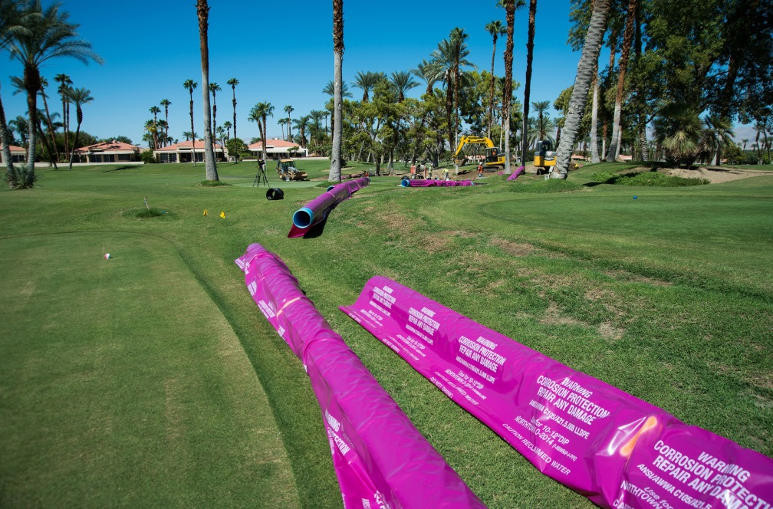
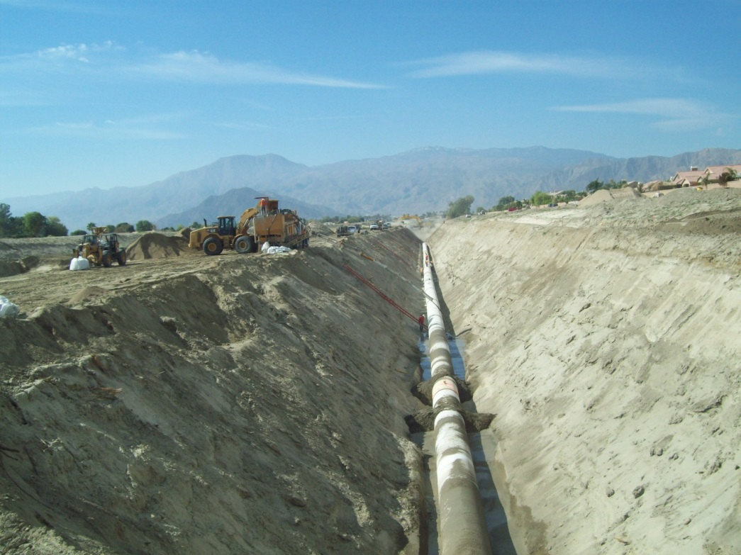

NPW Connections

Slide 34
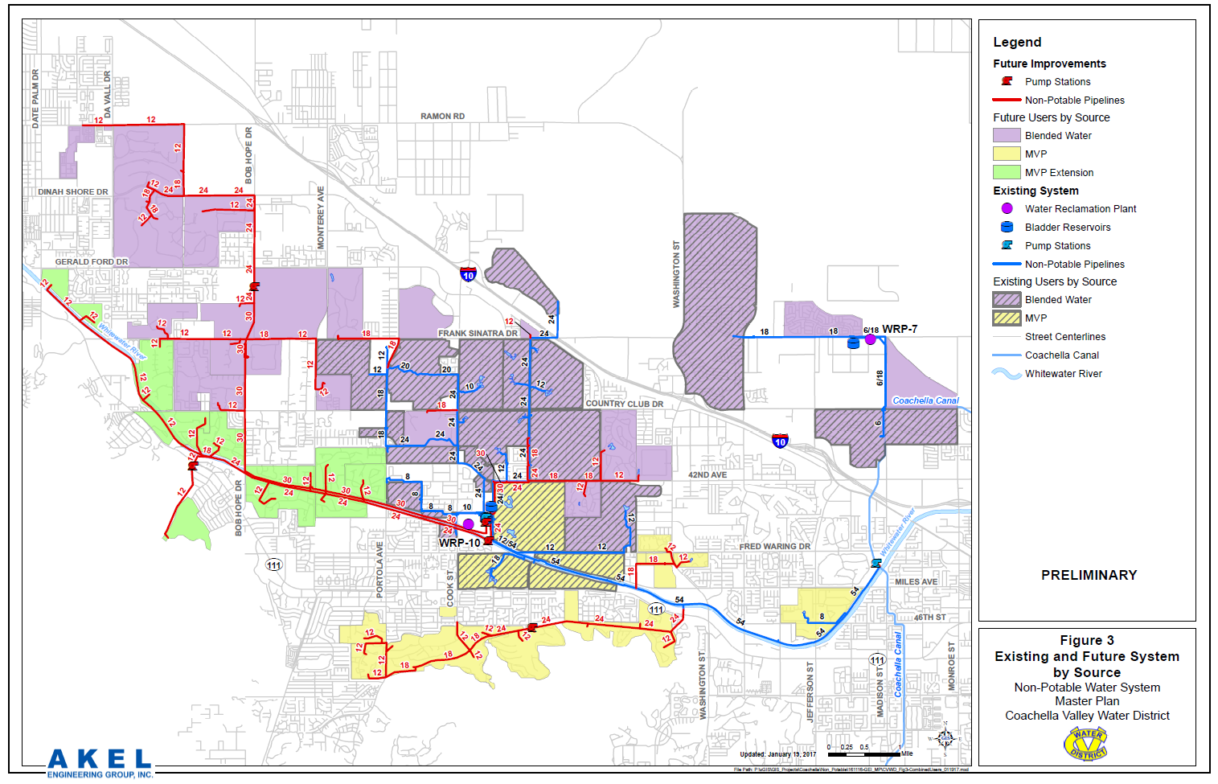

Slide 35
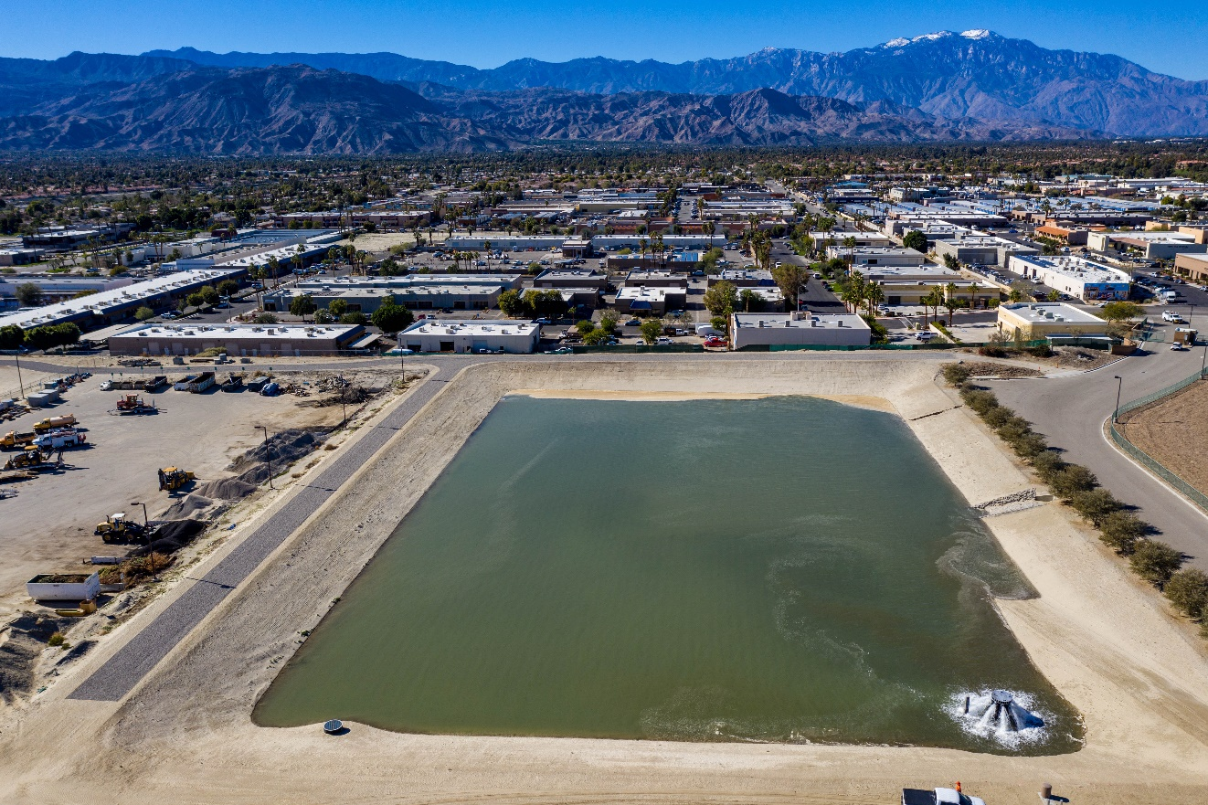
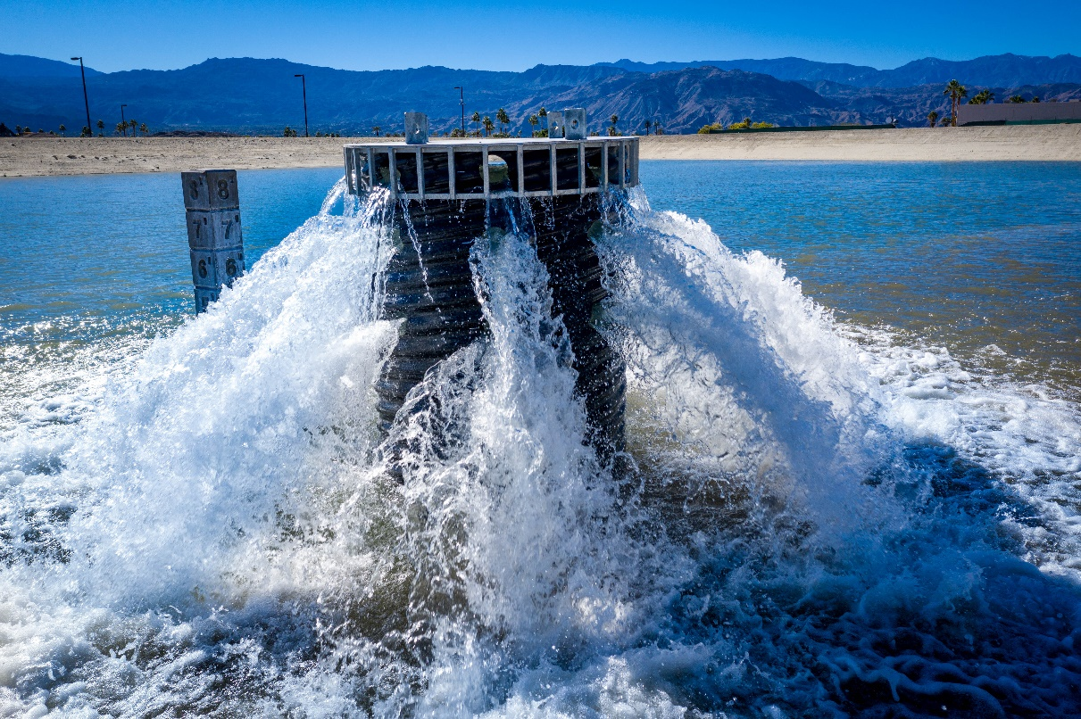

Slide 36
When NPW build out is complete…
Canal via Canal distribution system | 34.5
Canal via Mid Valley Pipeline | 23
Recycled Water/canal | 34.5
Not planned for an Alternate Water Supply | 13
Total Golf Courses: | 105
Nonpotable Water Source: | 92
Per Cent Using Nonpotable Water Source: | 88%

Slide 37
Golf courses using nonpotable water will allow potable water to be available for potable uses.
Estimated annual use of water is 1000 acft / year per golf course
1000 AFY x 120 golf courses= 120,000 AFY
30.5 golf courses in the east valley have access to canal water and 5 are focused on for future canal water use.
1000 AFY x (29.5 golf courses + 5 golf courses) = 34,500 AFY
23.5 golf courses in the mid-valley use nonpotable water.
1000 AFY x 23.5 golf courses = 23,500 AFY
6 golf courses in upper valley (DWA) use recycled water.
1000 AFY x 6 golf courses = 6,000 AFY
The future Mid-Valley Pipeline Project, includes 34 golf courses in mid-valley to use recycled/canal water blend
1000 AFY x 34 golf courses = 34,000 AFY
120,000 AFY – 34,500 AFY – 23,500 AFY - 6,000 AFY – 34,000 AFY = 22,000 AFY

Slide 38

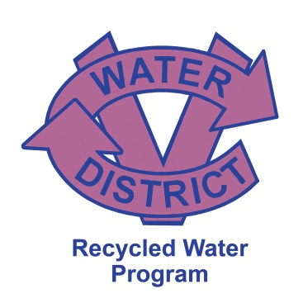
Thank you
Olivia Bennett
Nonpotable Water Operations Manager

